Slide 1

INTRODUCTION TO VISUAL ARTS
Workshop 1 - Architecture
ArtWorks NYC Program 2022

Slide 2
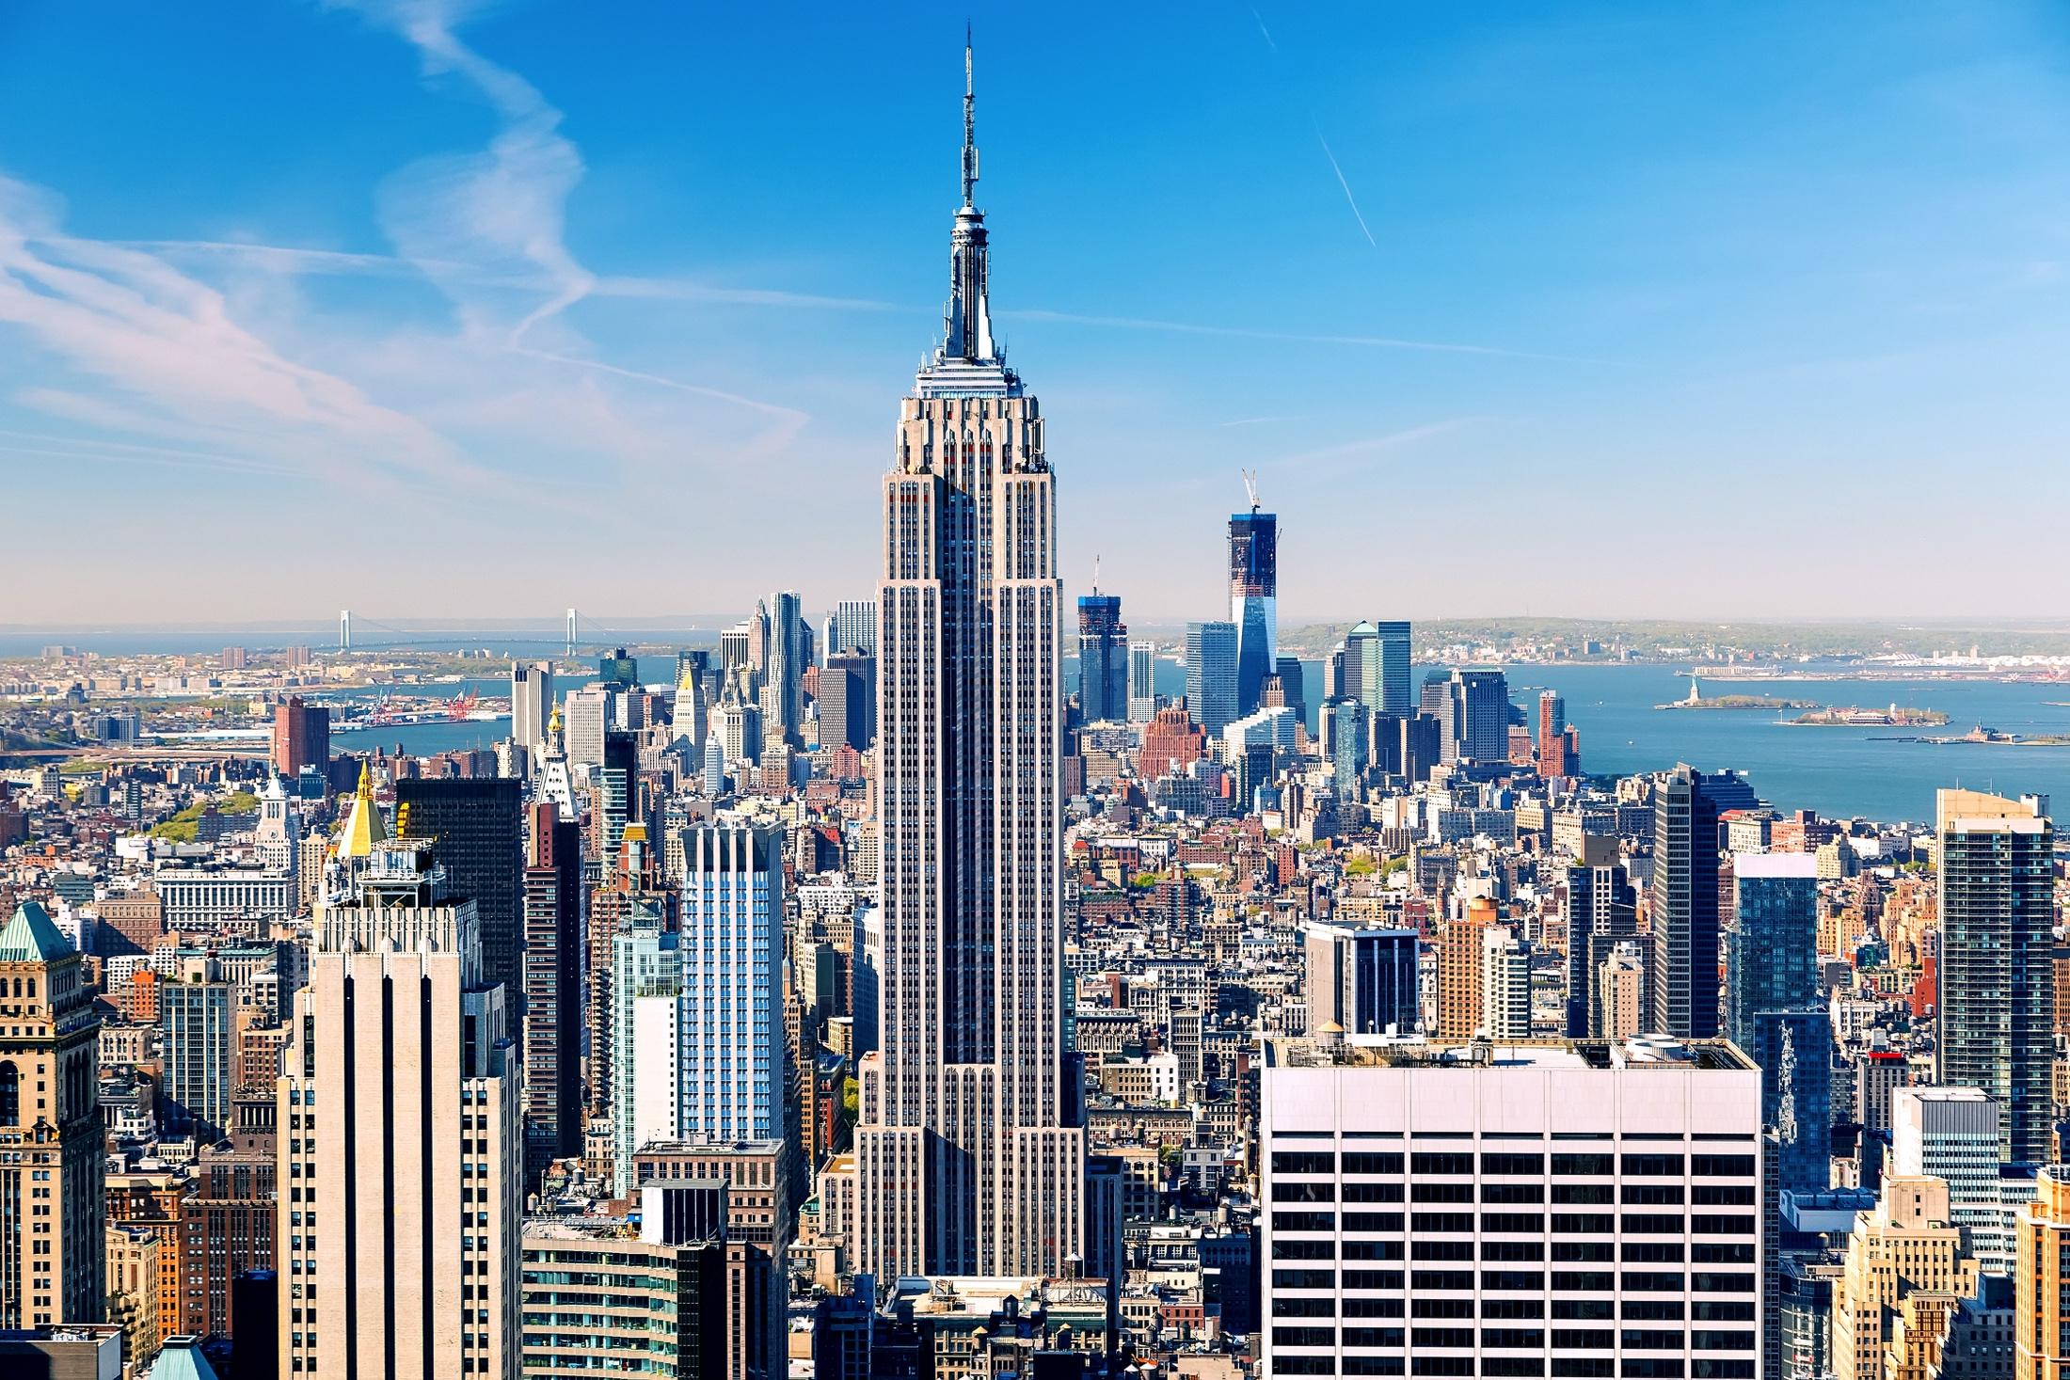

Slide 3
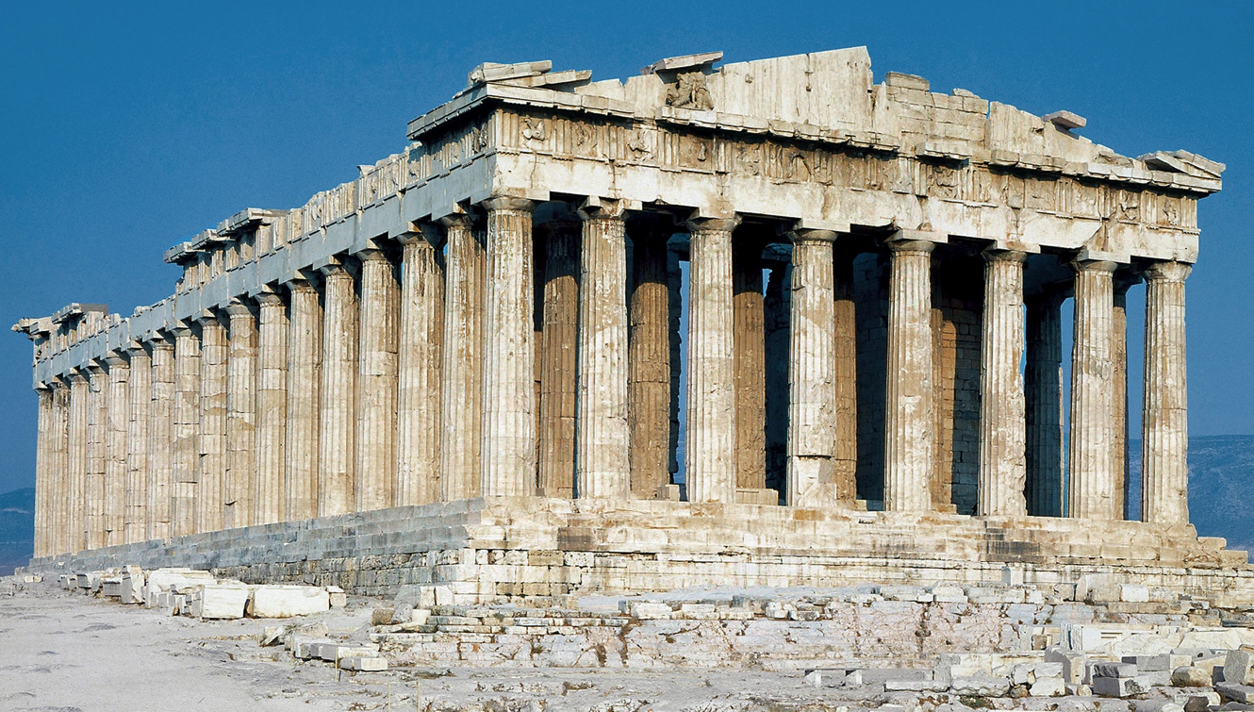

Slide 4
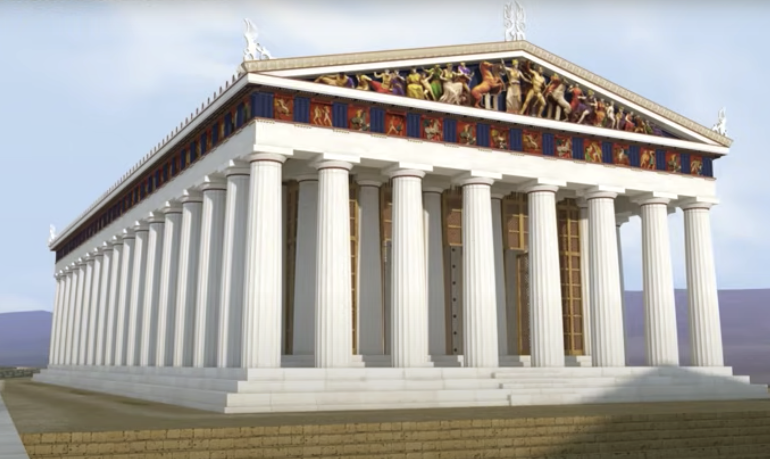
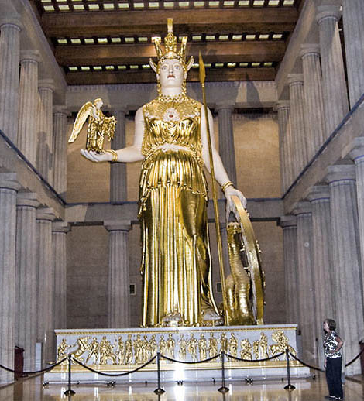

Slide 5
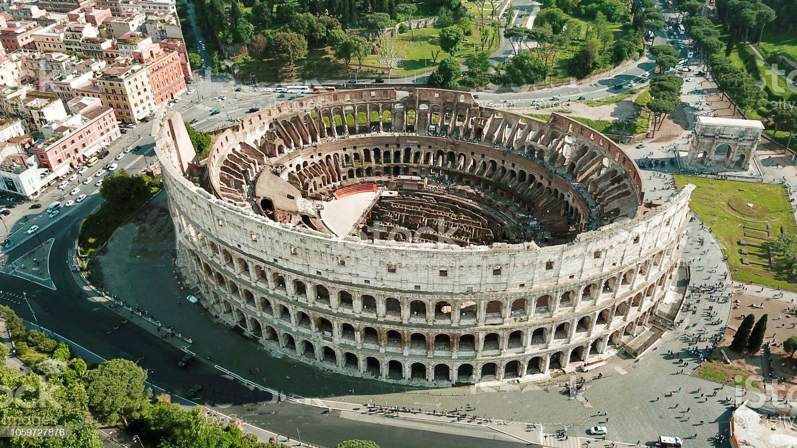

Slide 6
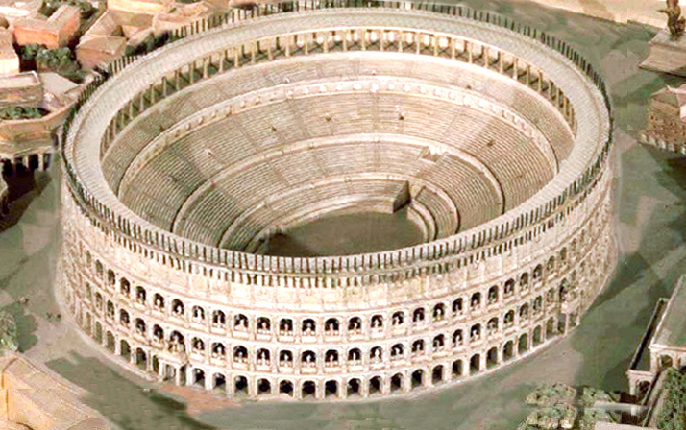

Slide 7
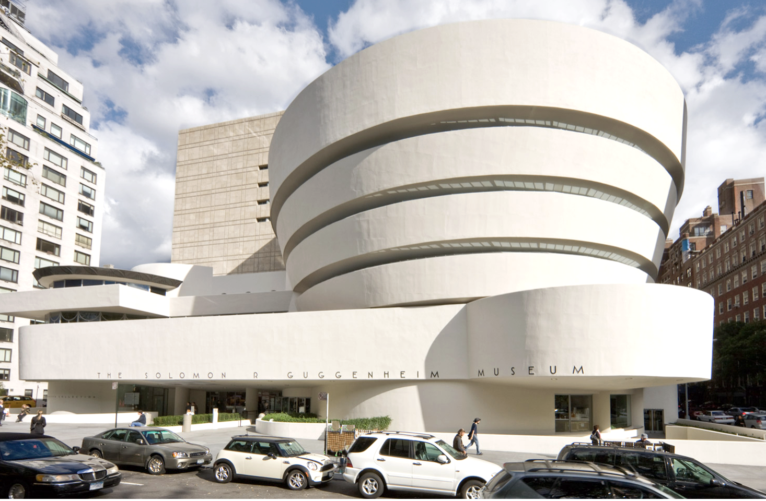

Slide 8
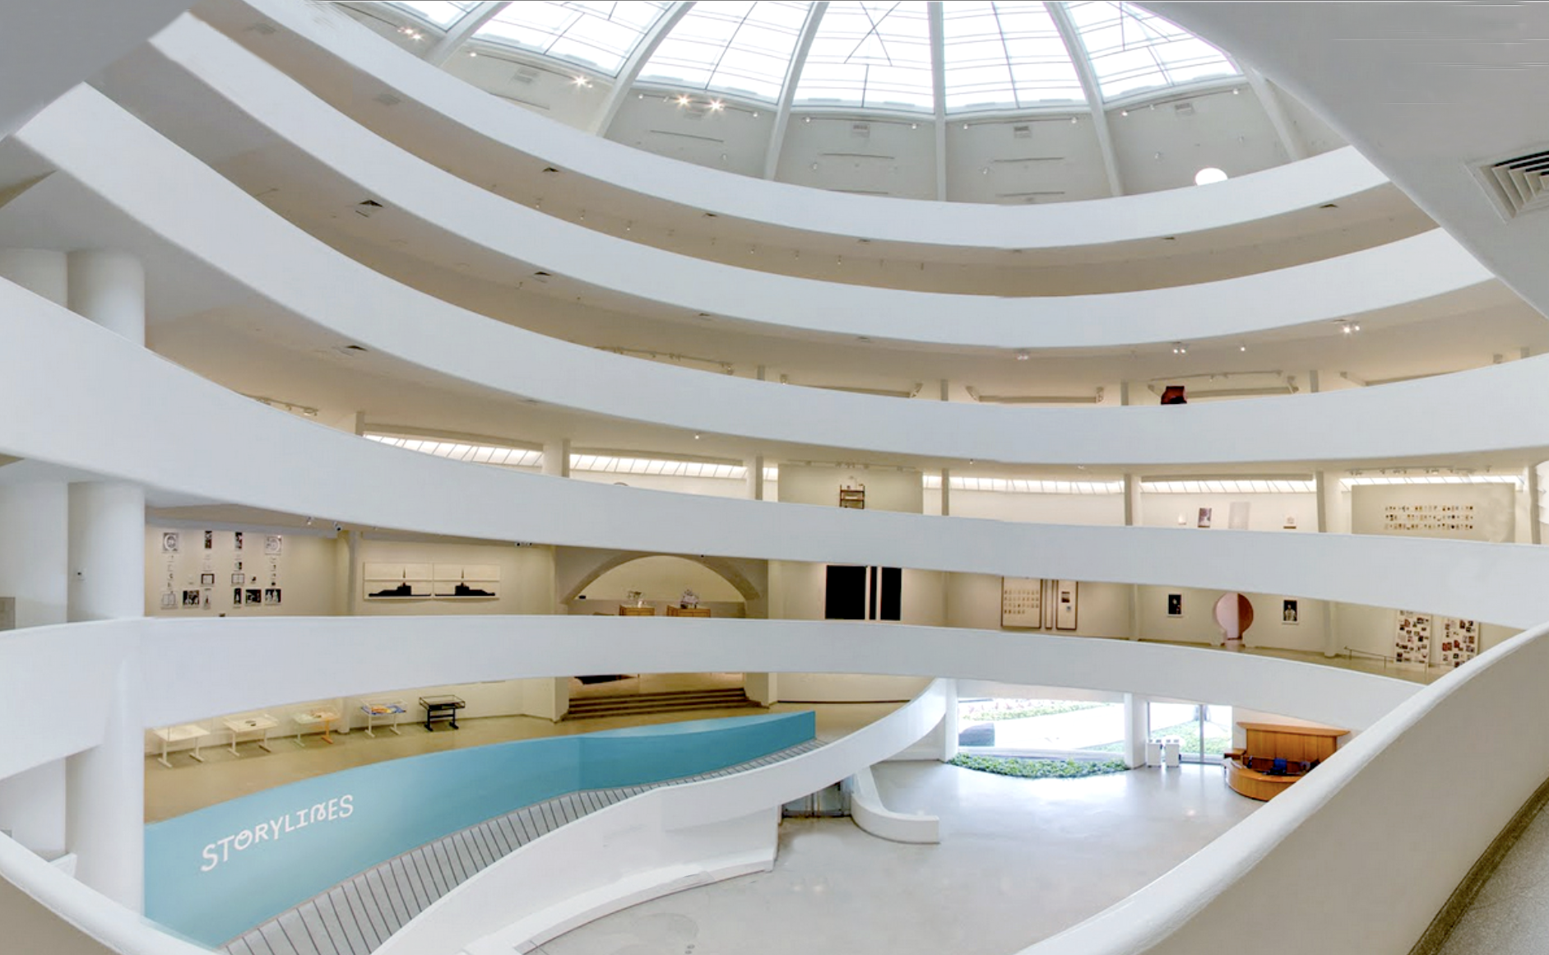

Slide 9
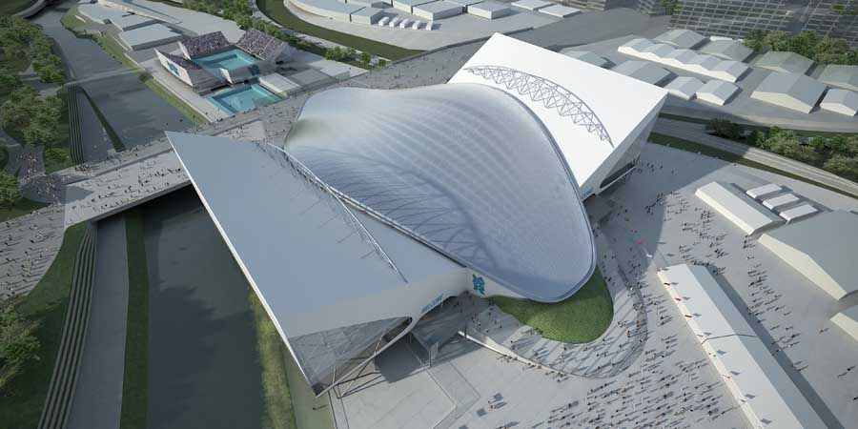

Slide 10
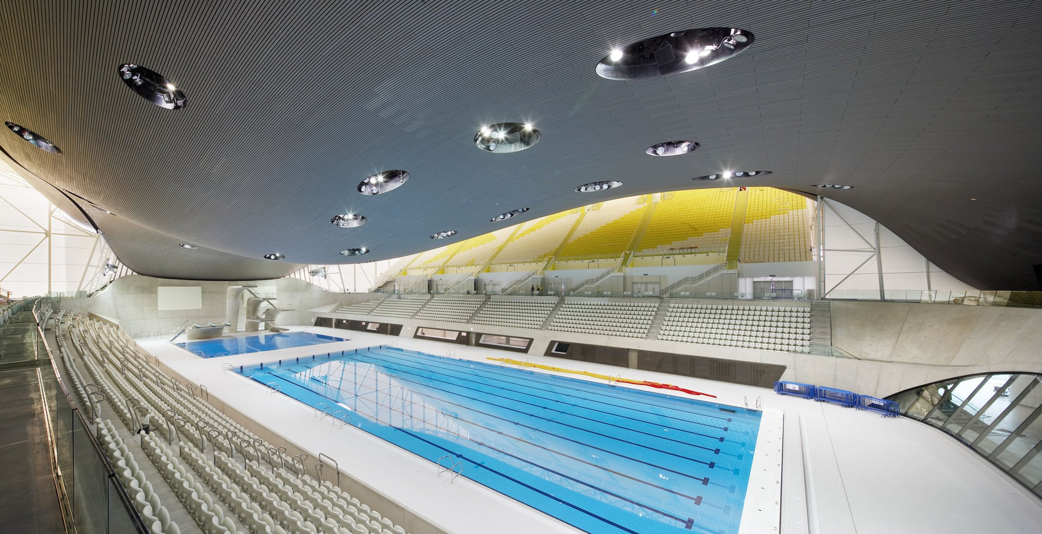

Slide 11
INTRODUCTION TO VISUAL ARTS
Workshop 2 – Sculpture
ArtWorks NYC Program 2022

Slide 12
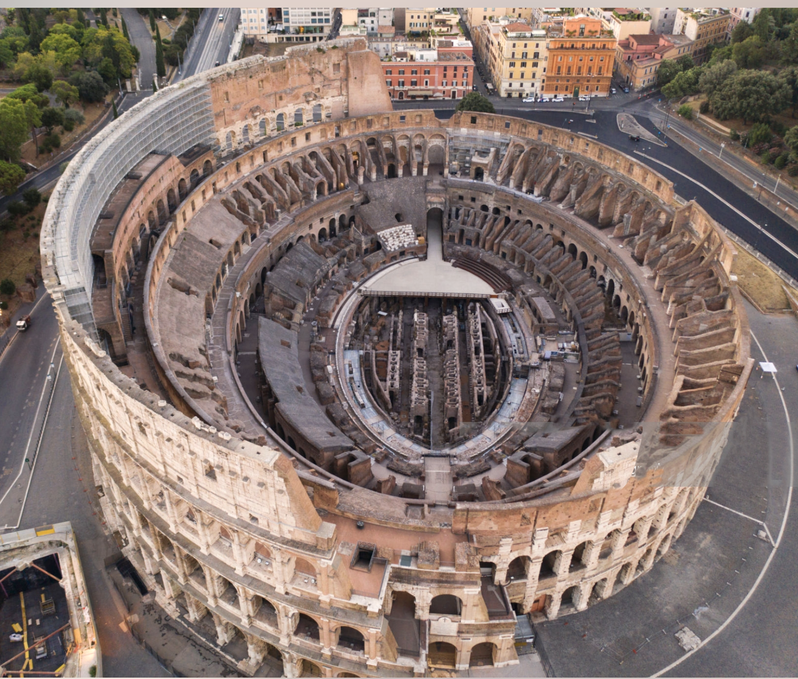
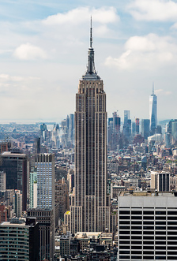
Architecture Review
1
2
3
4
5

Slide 13
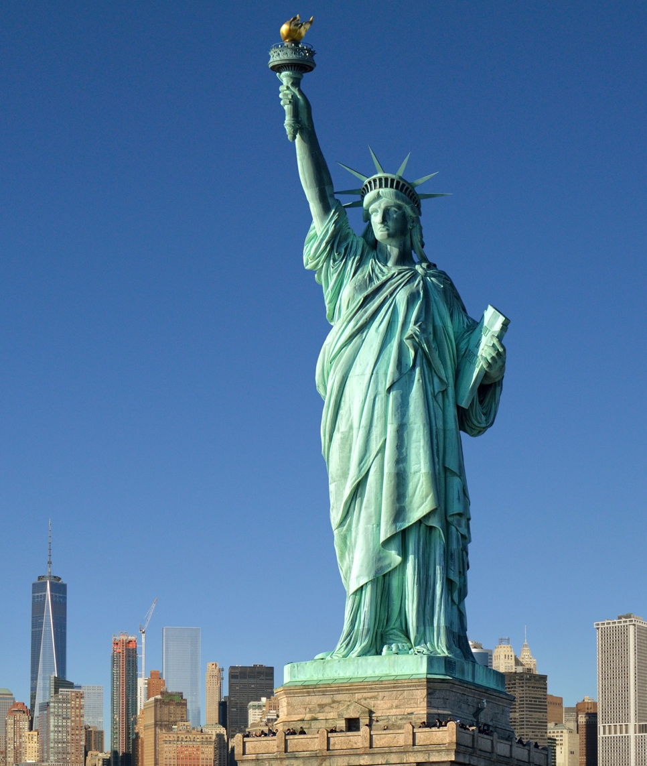

Slide 14
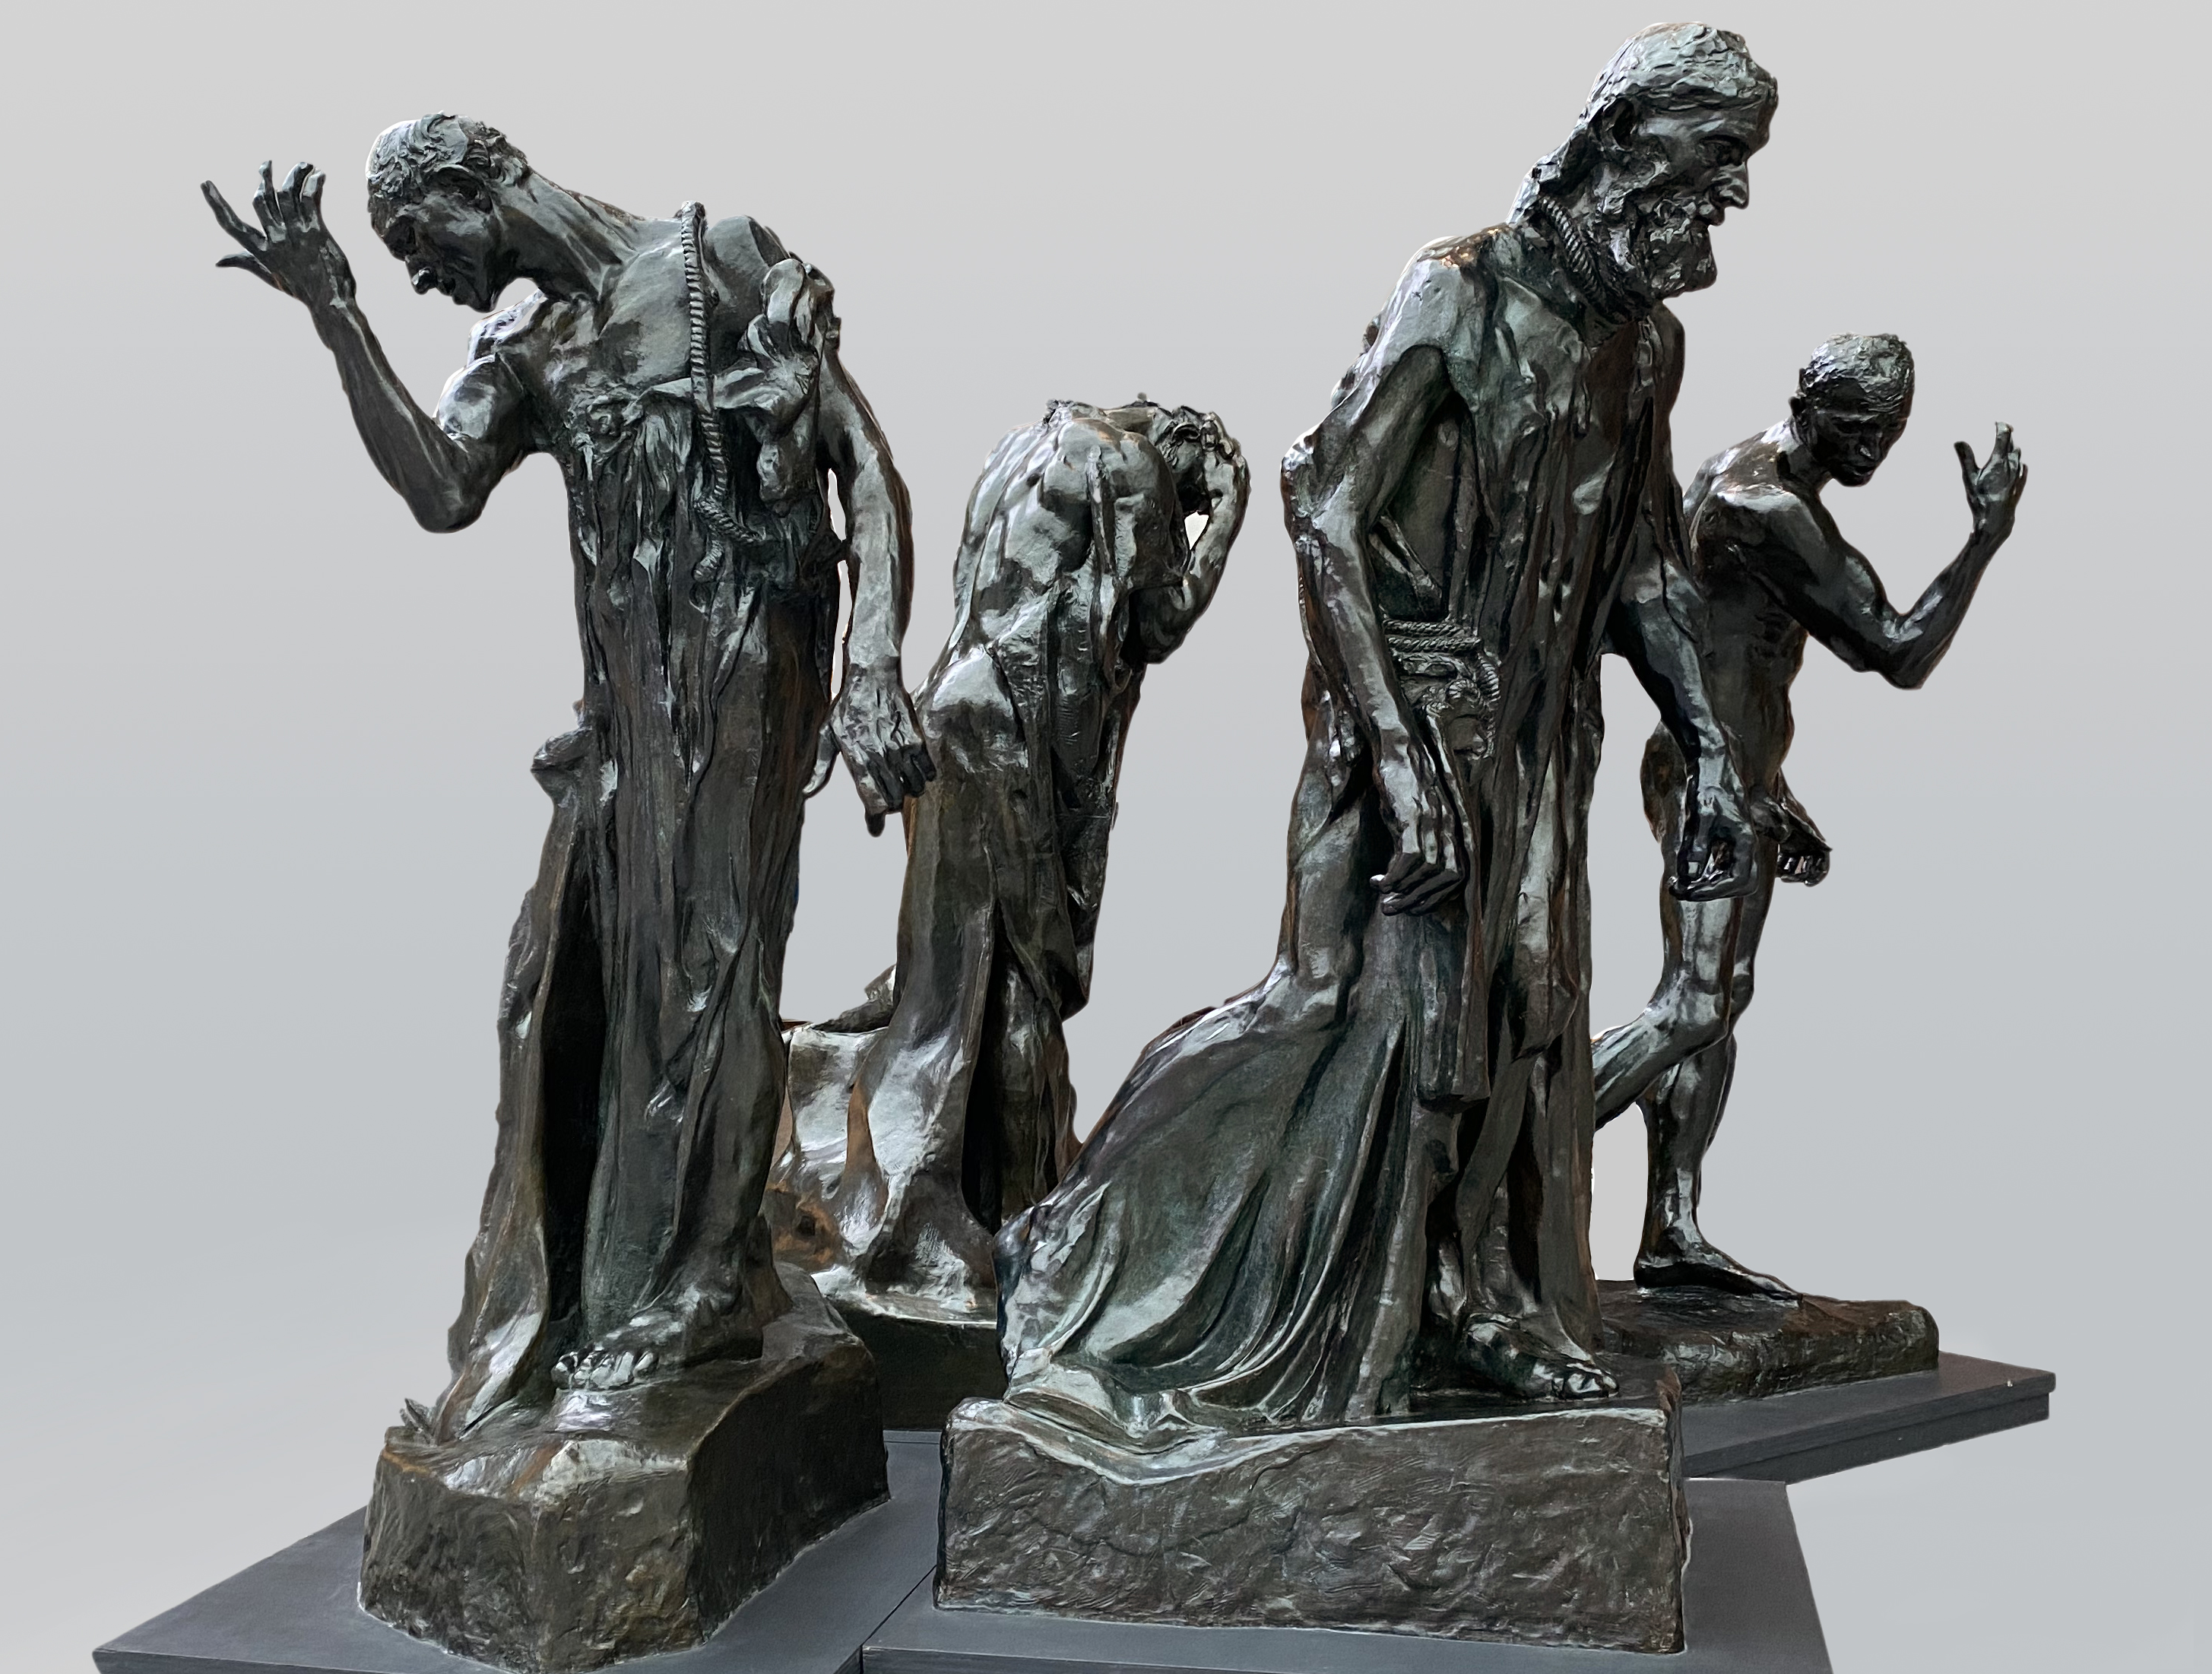

Slide 15
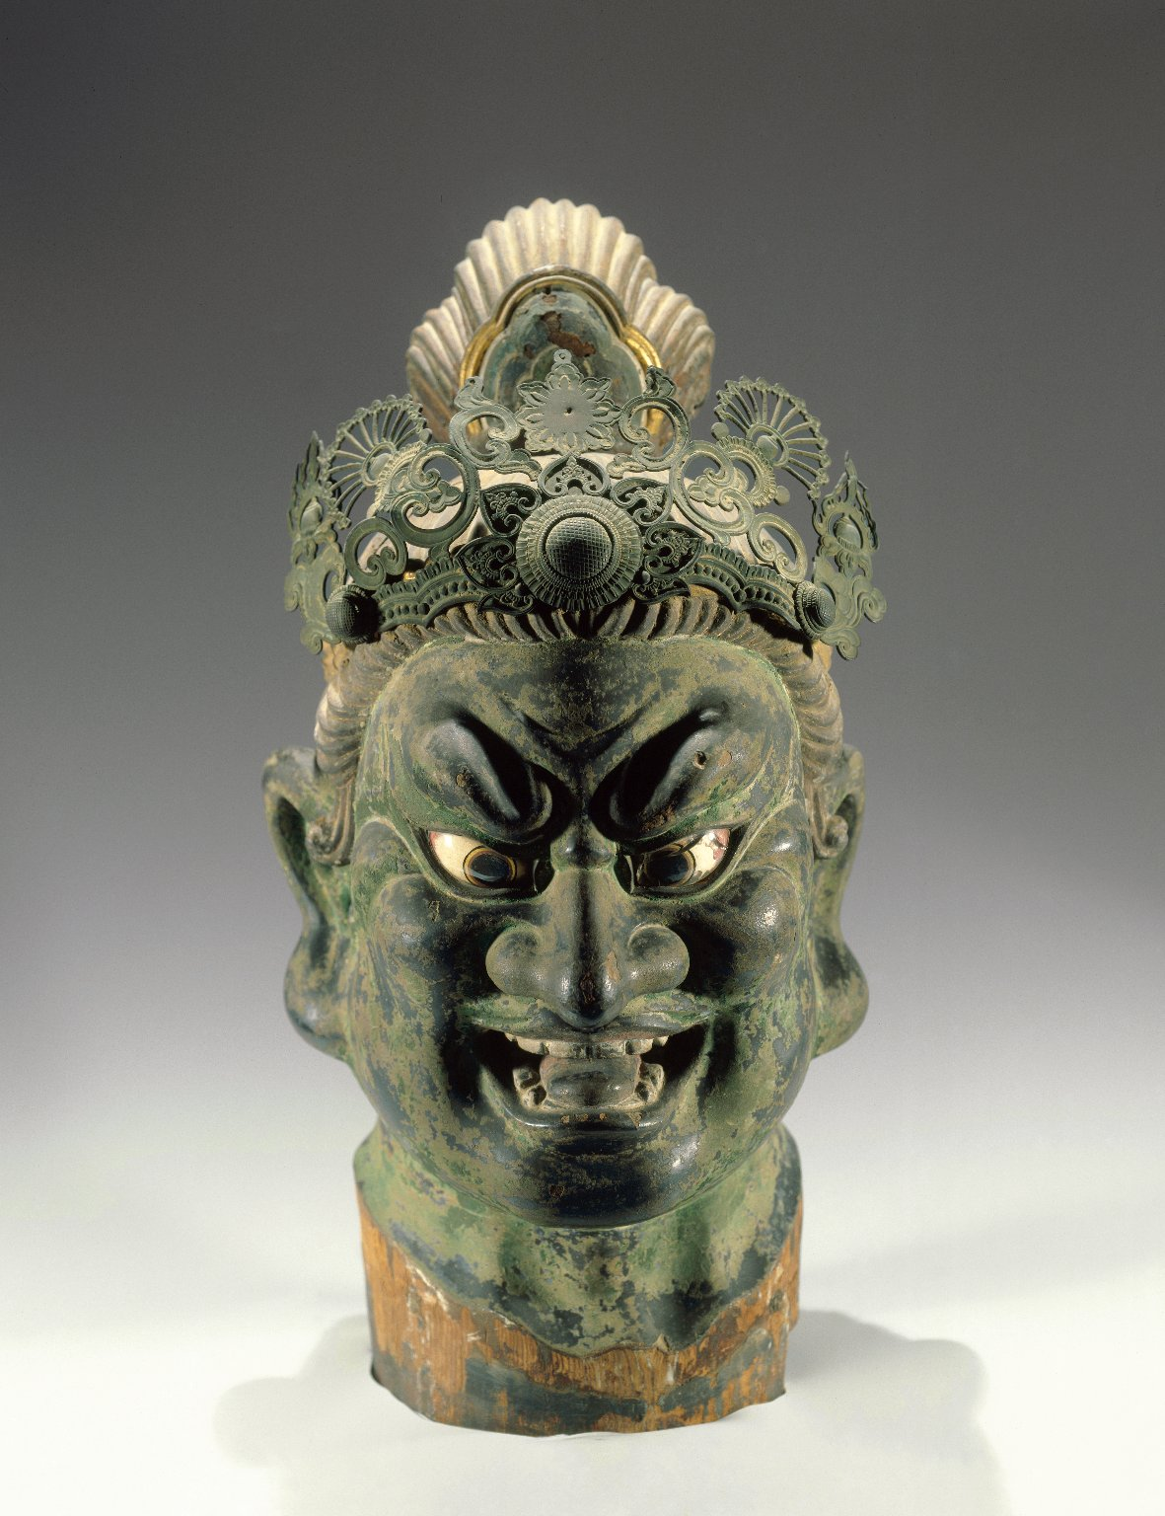

Slide 16
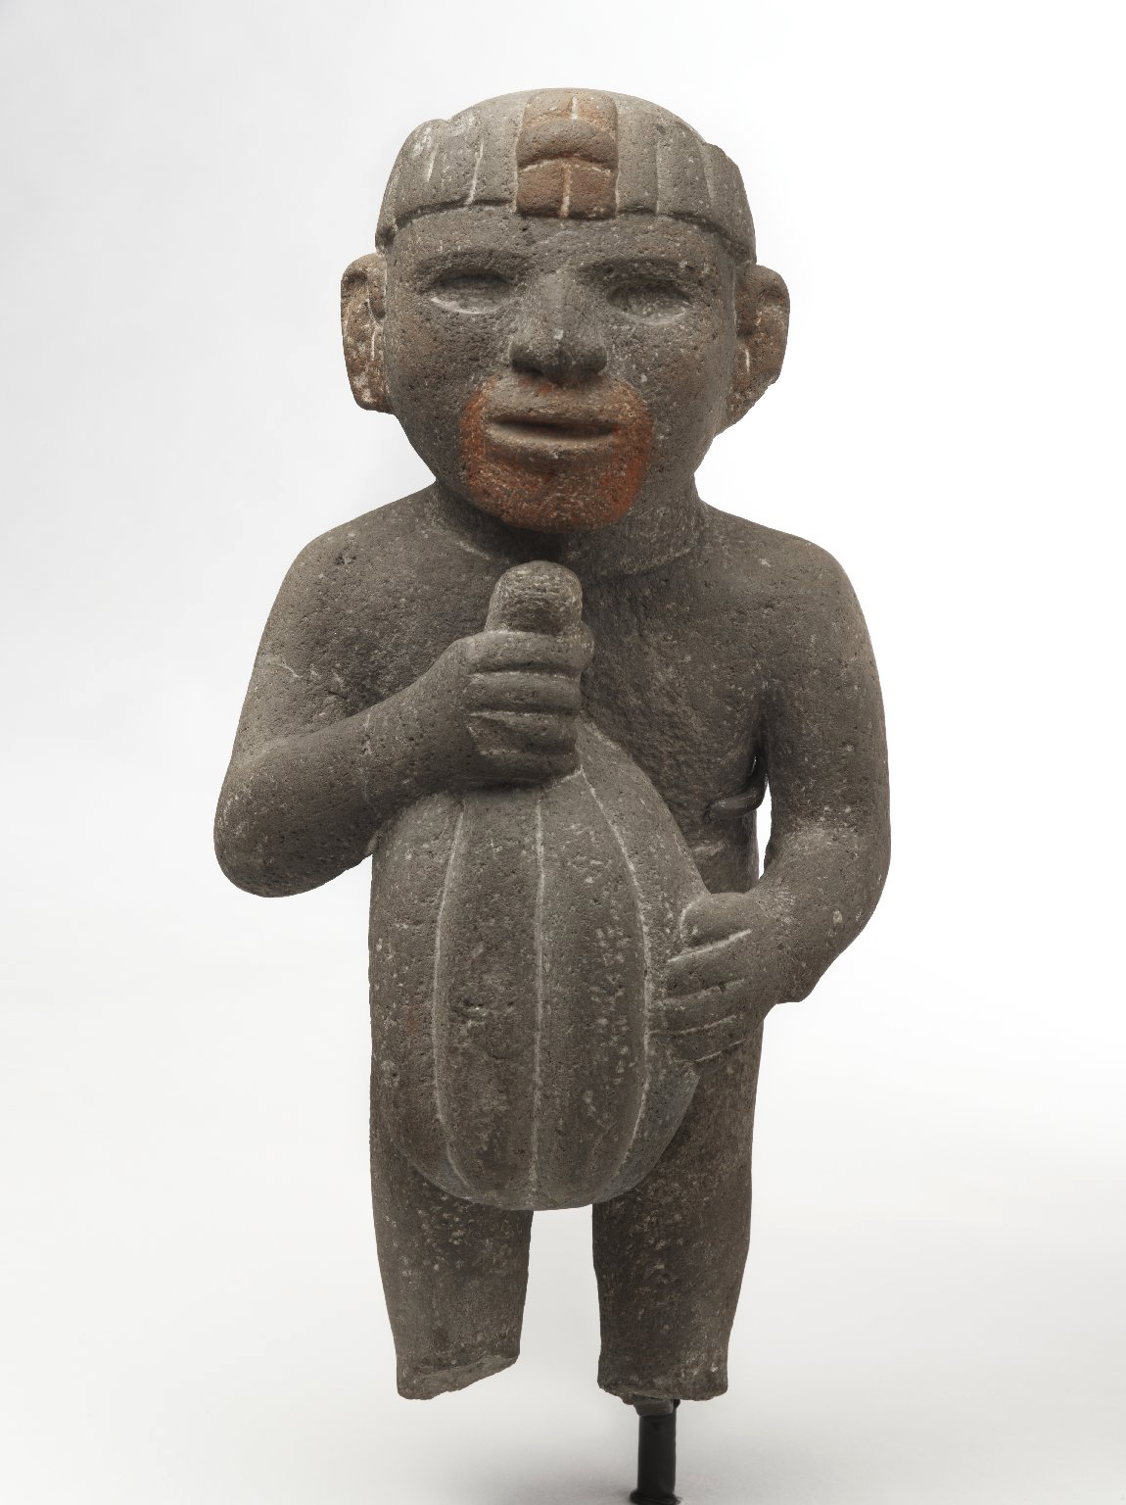

Slide 17


Slide 18


Slide 19
INTRODUCTION TO VISUAL ARTS
Workshop 3 – Painting
ArtWorks NYC Program 2022

Slide 20
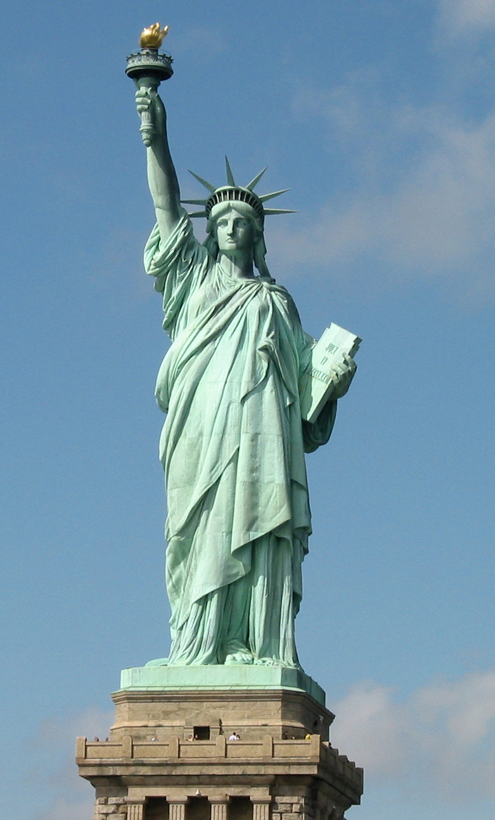

1
2
3
Sculpture Review
4
5
ArtWorks NYC Program 2021

Slide 21
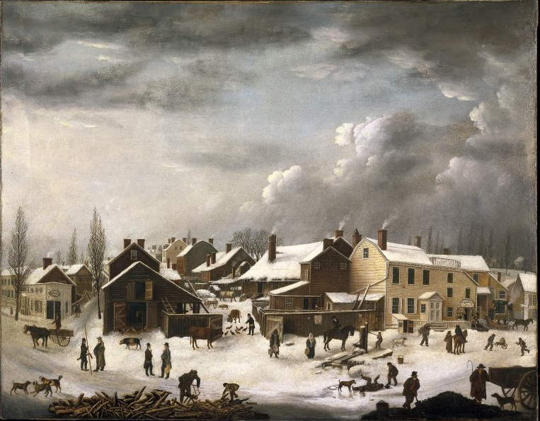

Slide 22
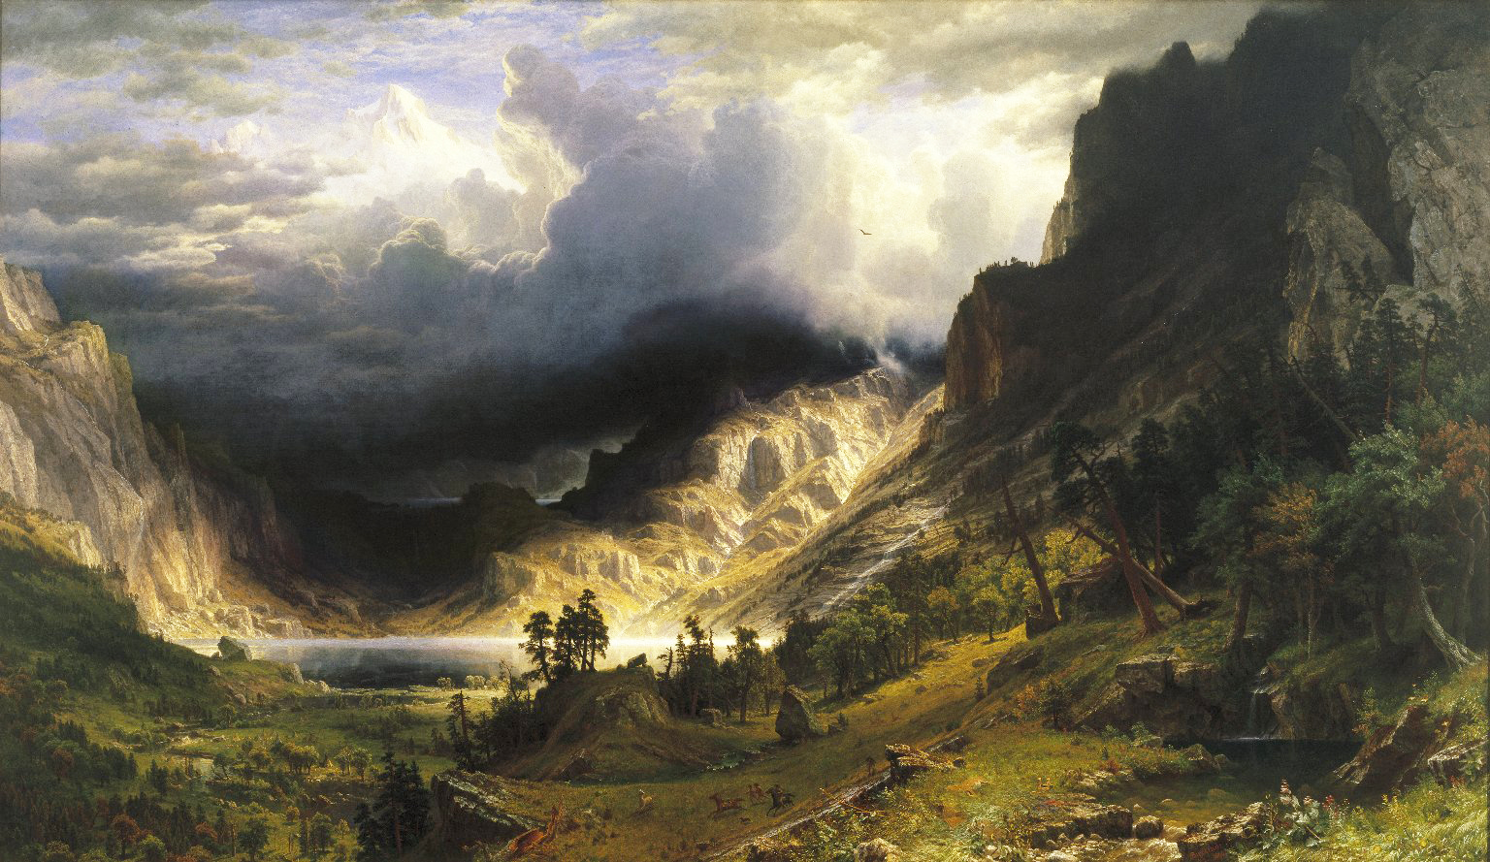

Slide 23
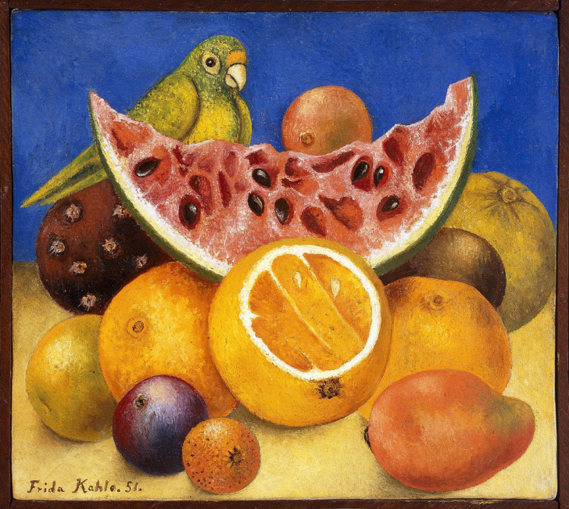

Slide 24
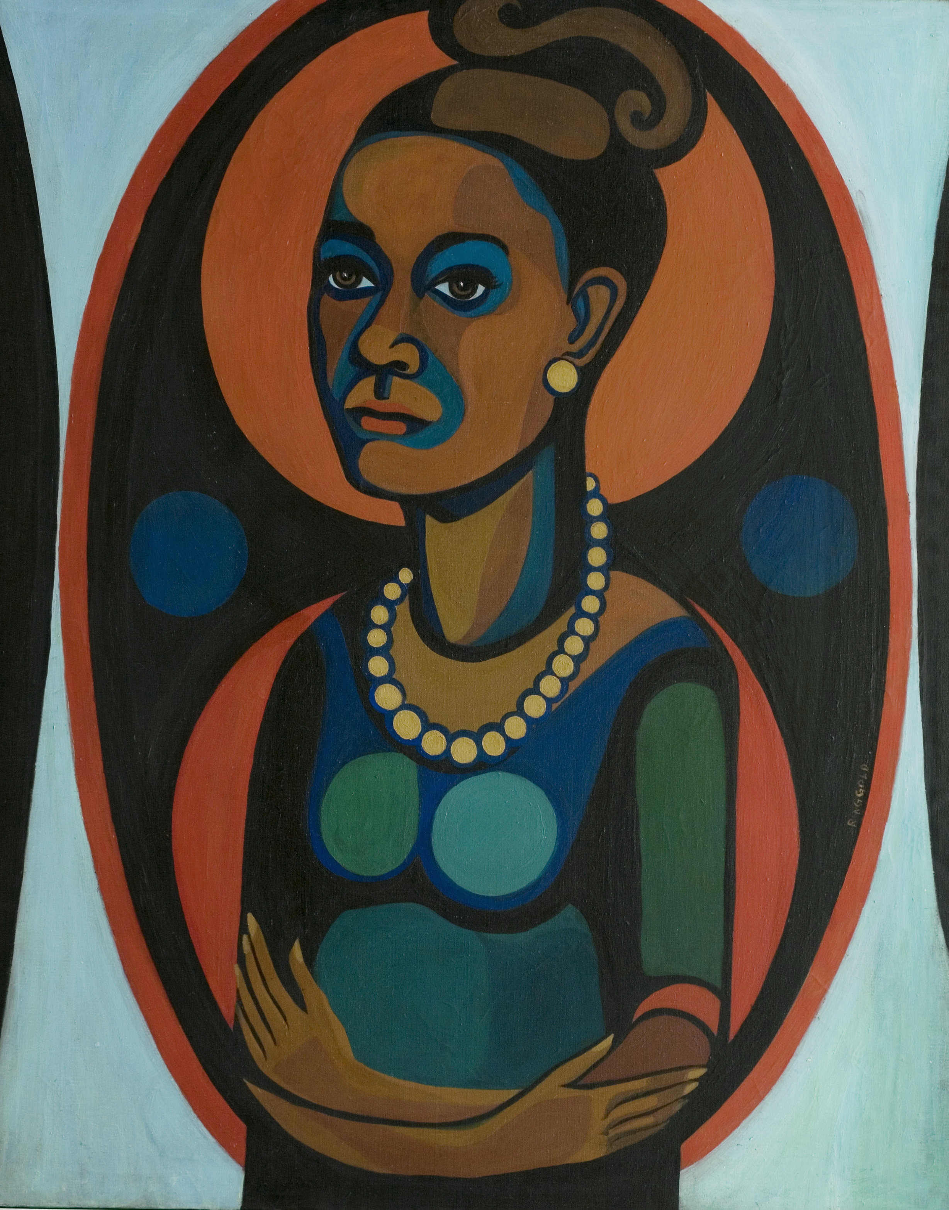

Slide 25
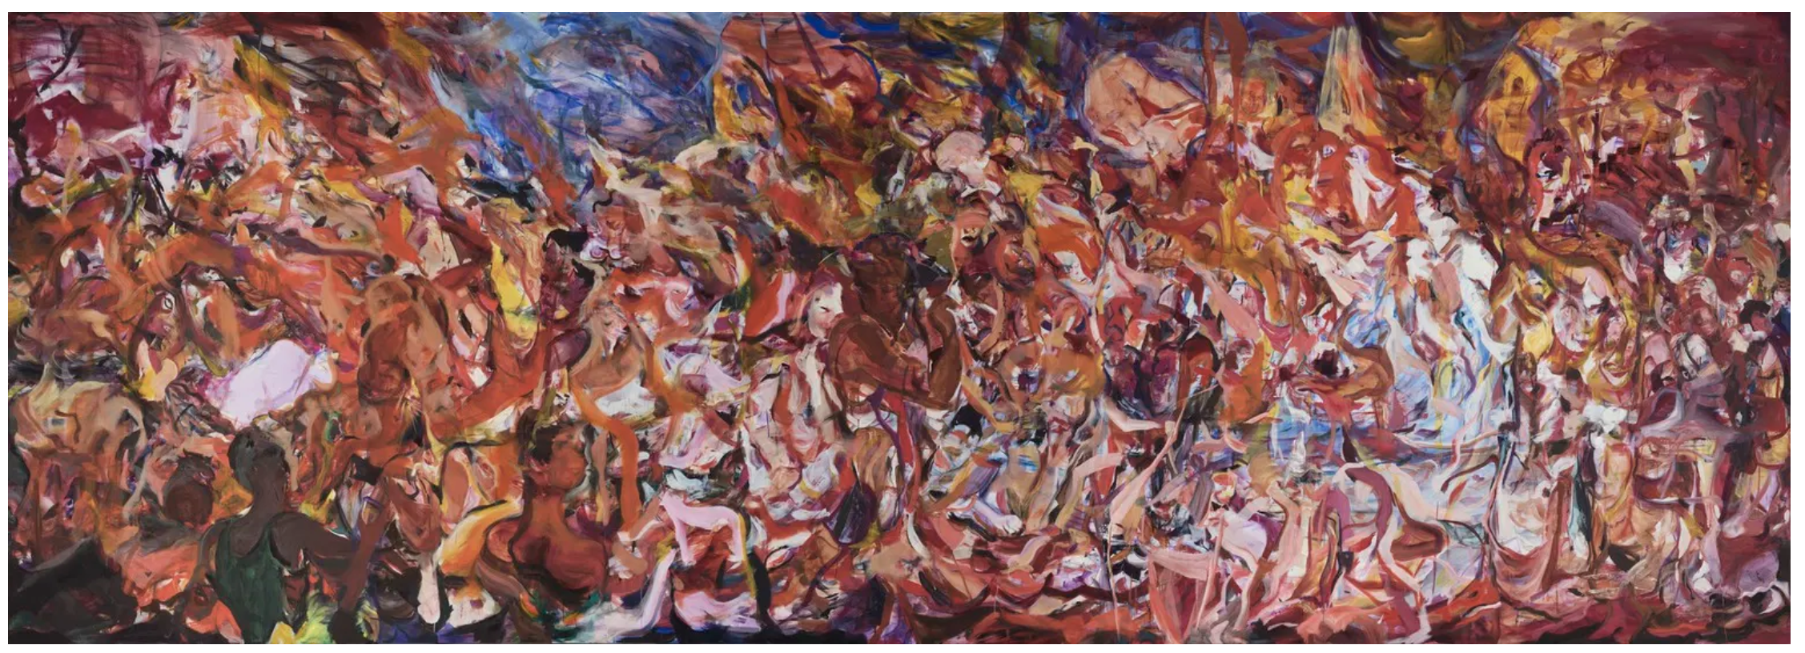

Slide 26
INTRODUCTION TO VISUAL ARTS
Workshop 4 – Decorative Art
ArtWorks NYC Program 2022

Slide 27
Painting Review
1
2
3
4
5

Slide 28
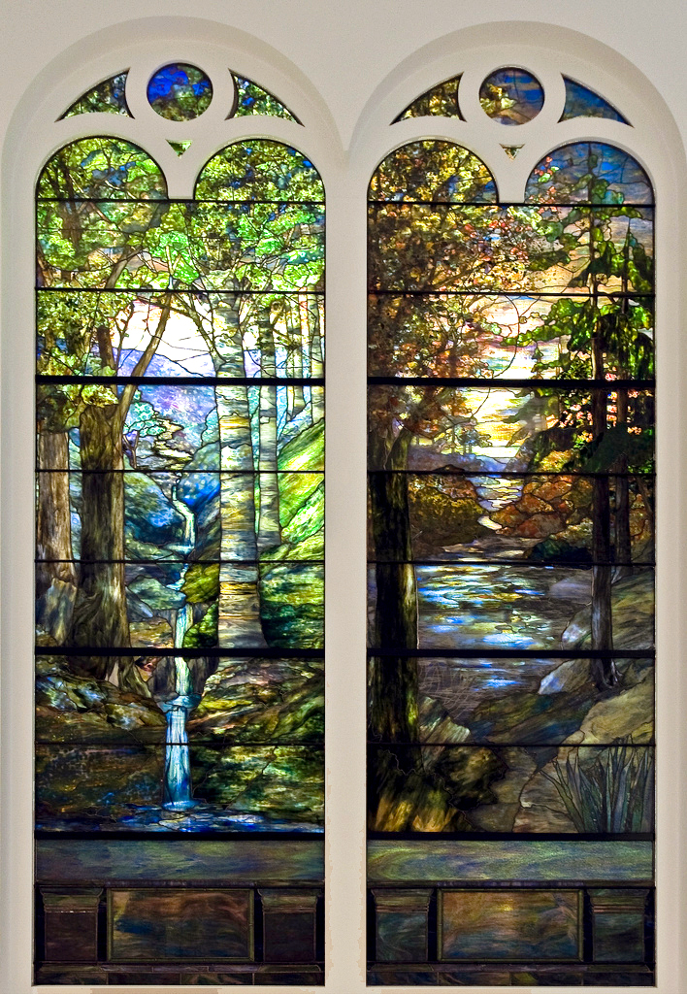

Slide 29
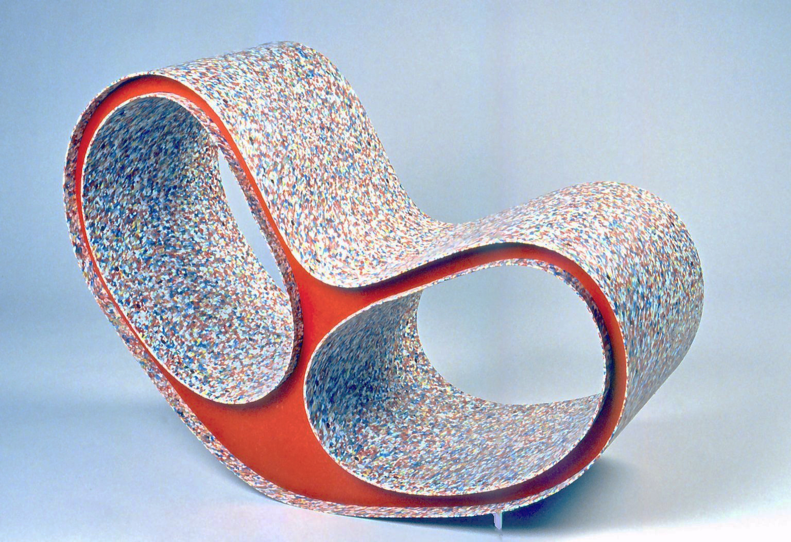

Slide 30
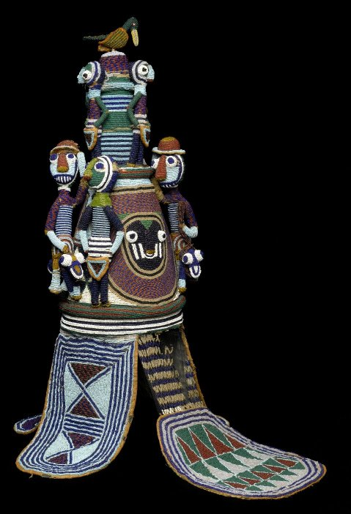

Slide 31
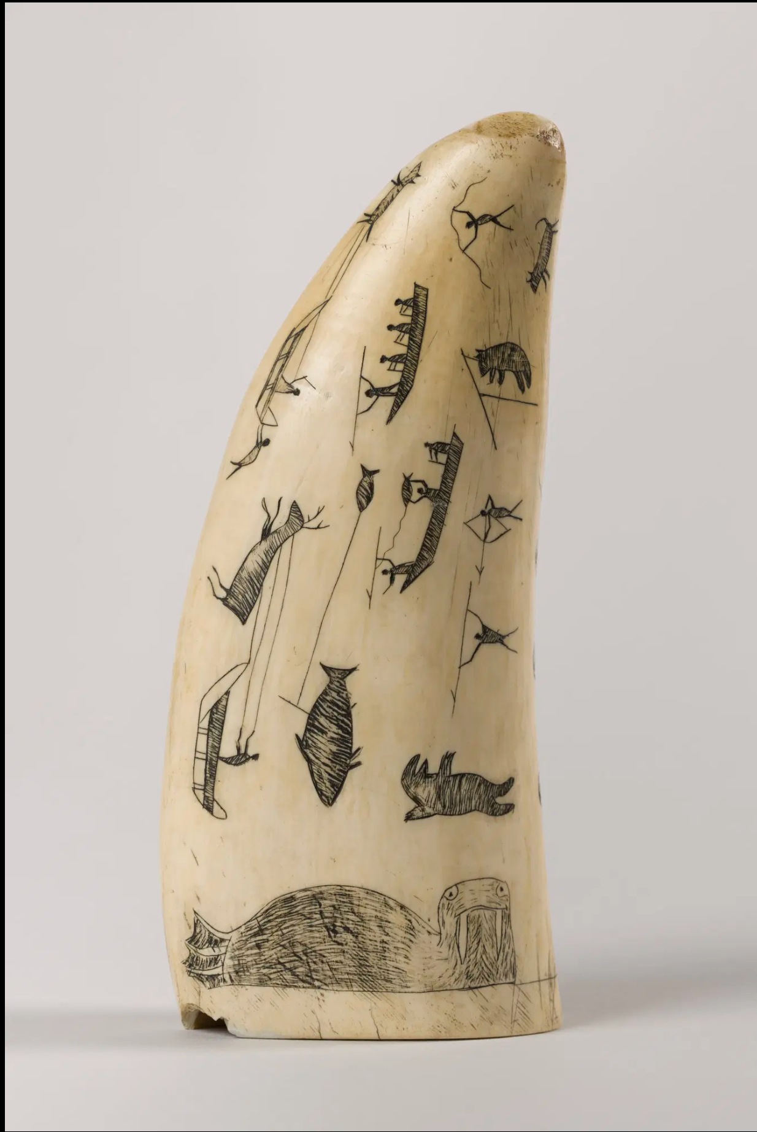

Slide 32
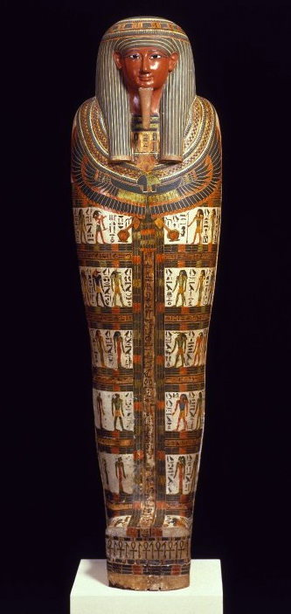
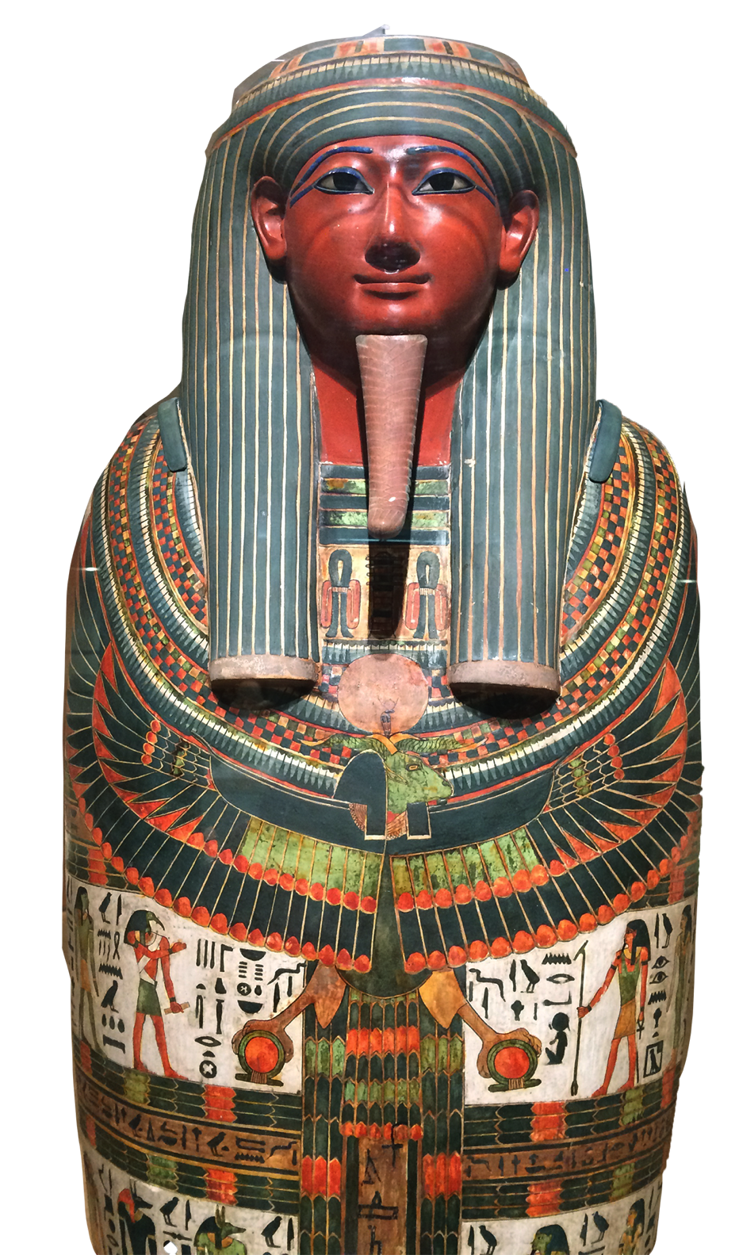
Close up

