Slide 1

INTRODUCTION TO VISUAL ARTS
Workshop 1 - Architecture
ArtWorks NYC Program 2022

Slide 2
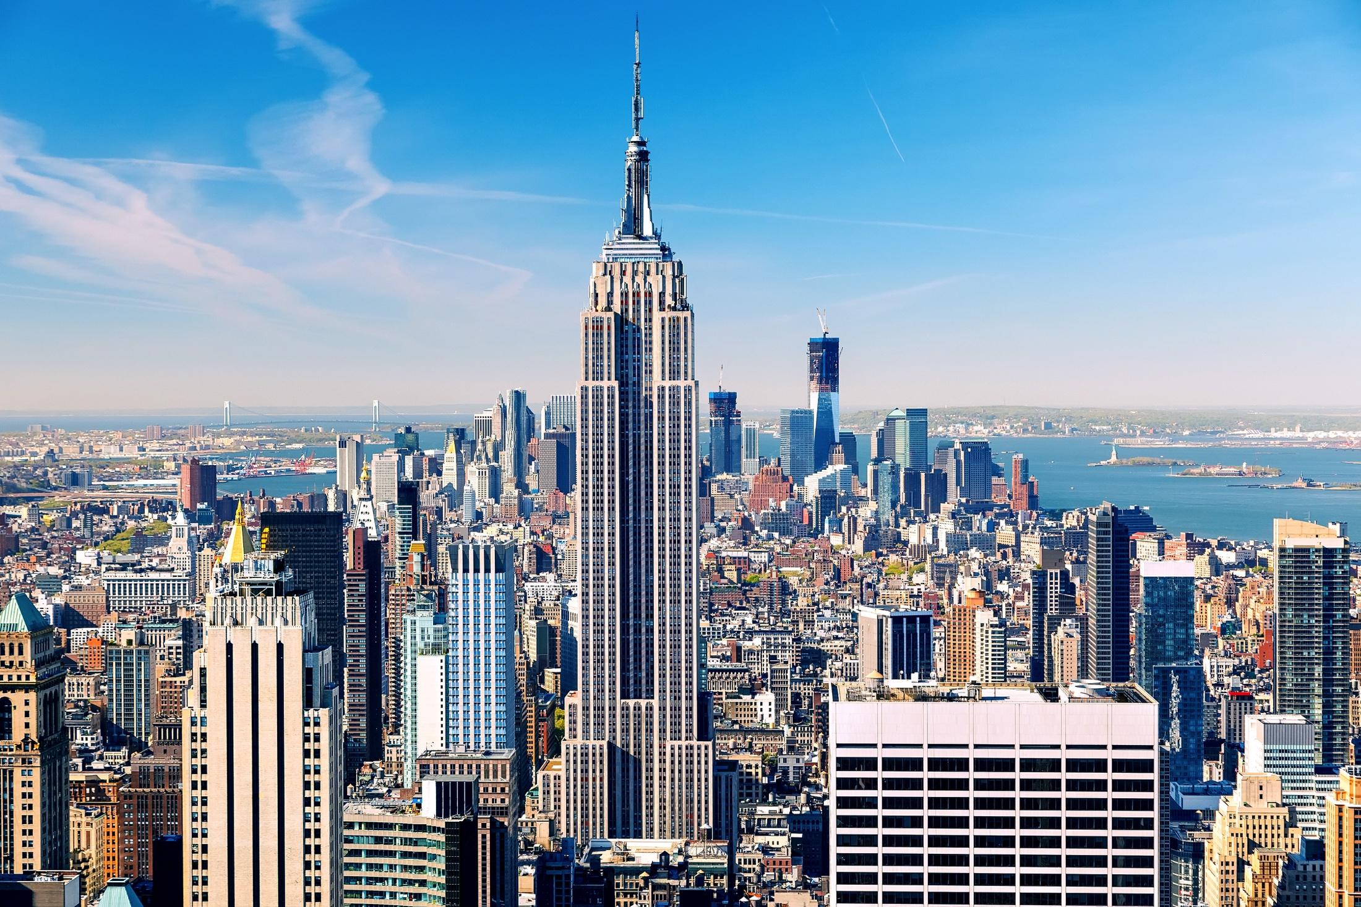

Slide 3
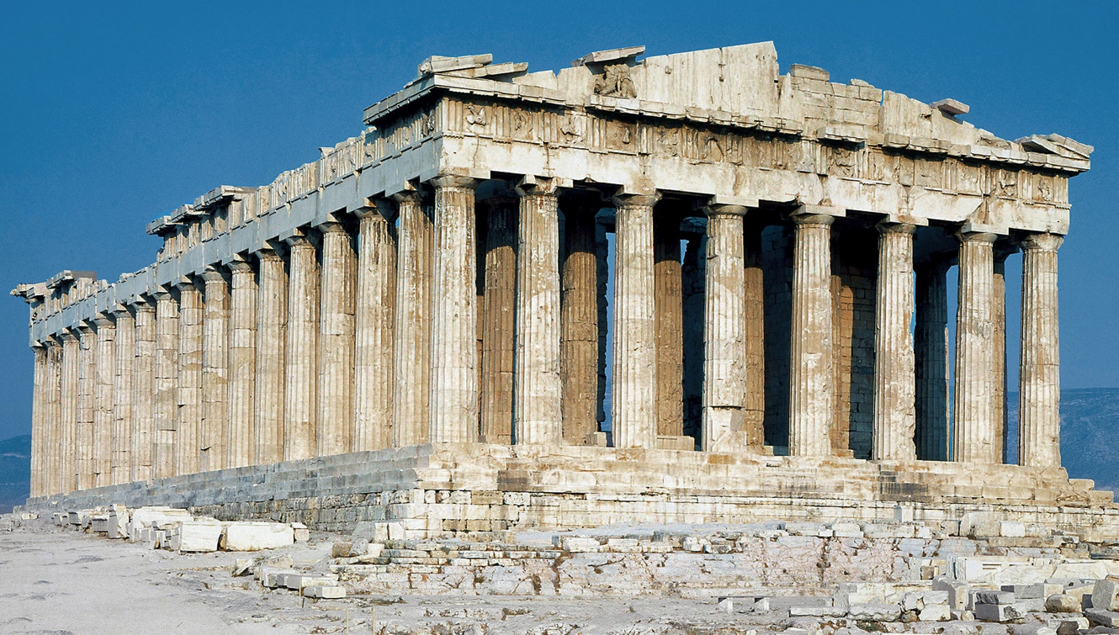

Slide 4
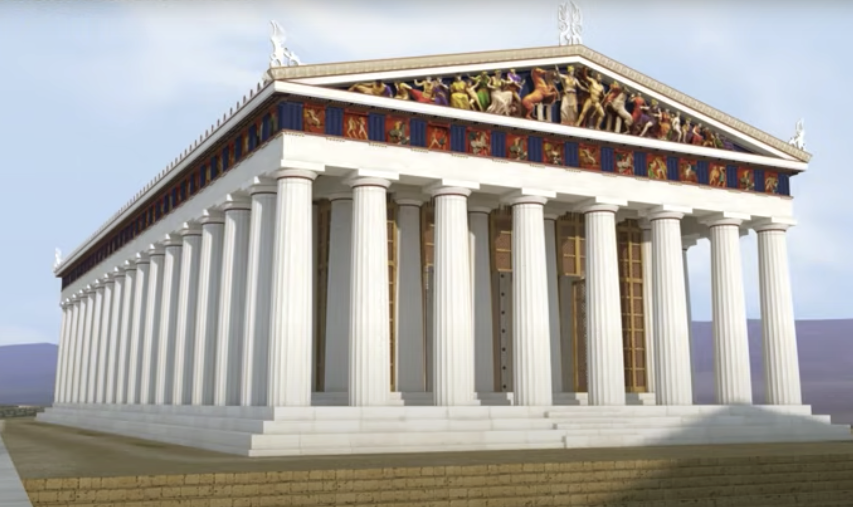
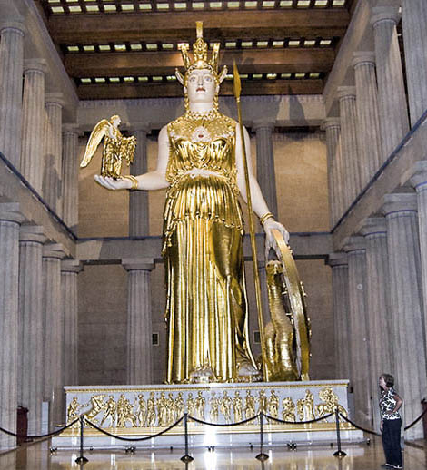

Slide 5
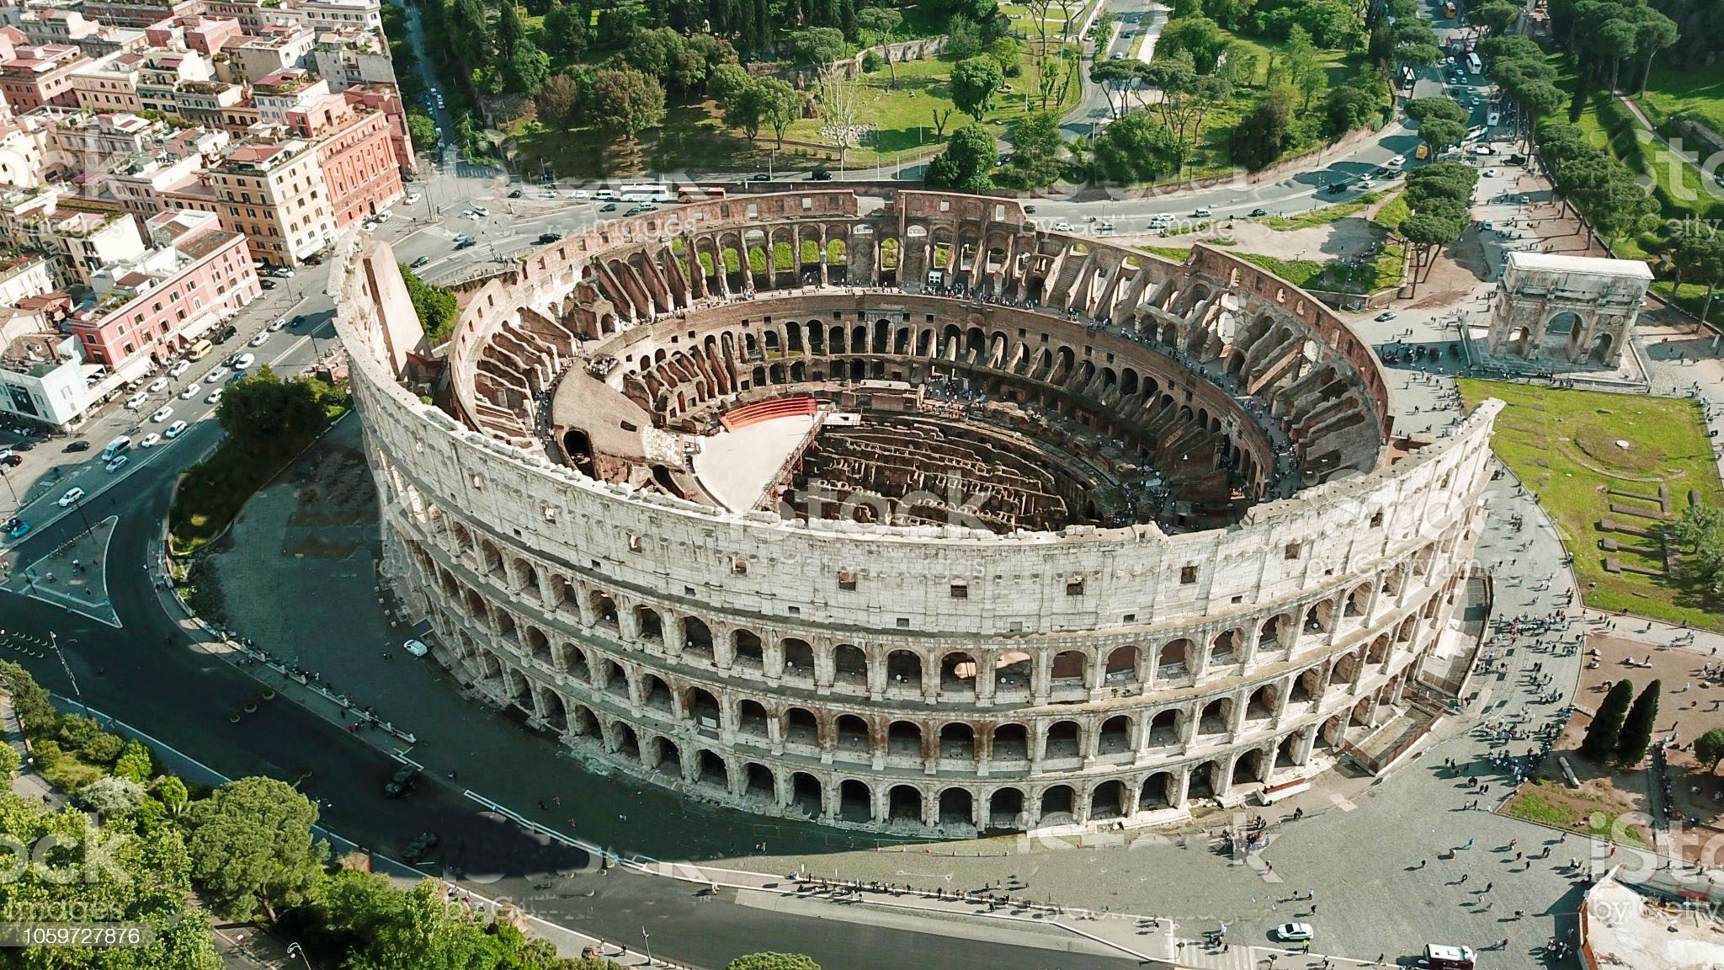

Slide 6
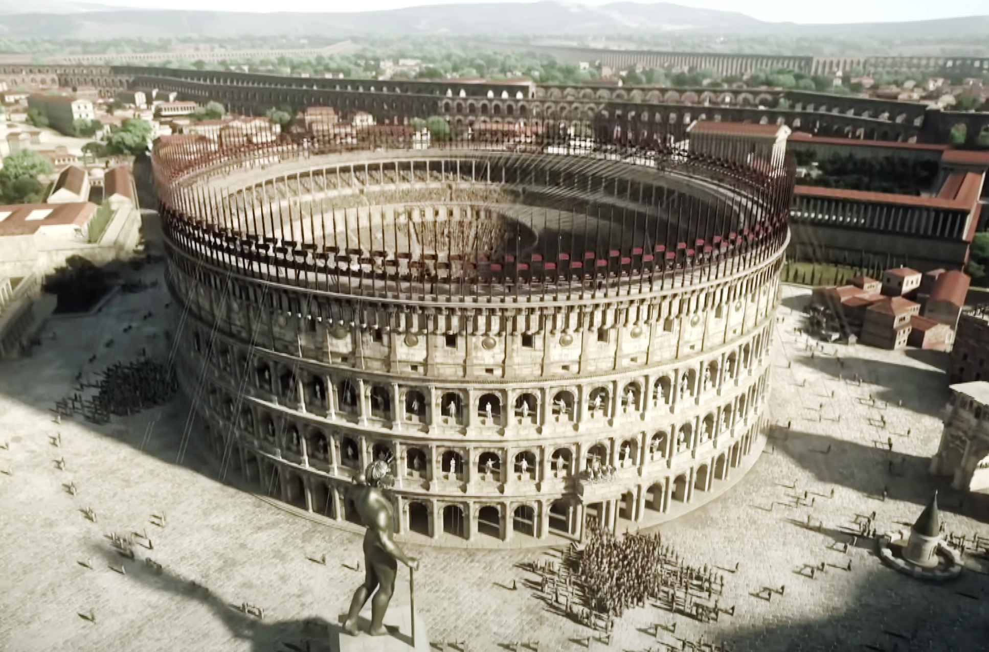

Slide 7
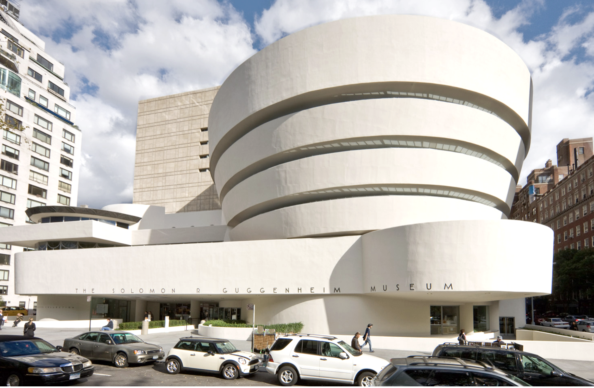

Slide 8
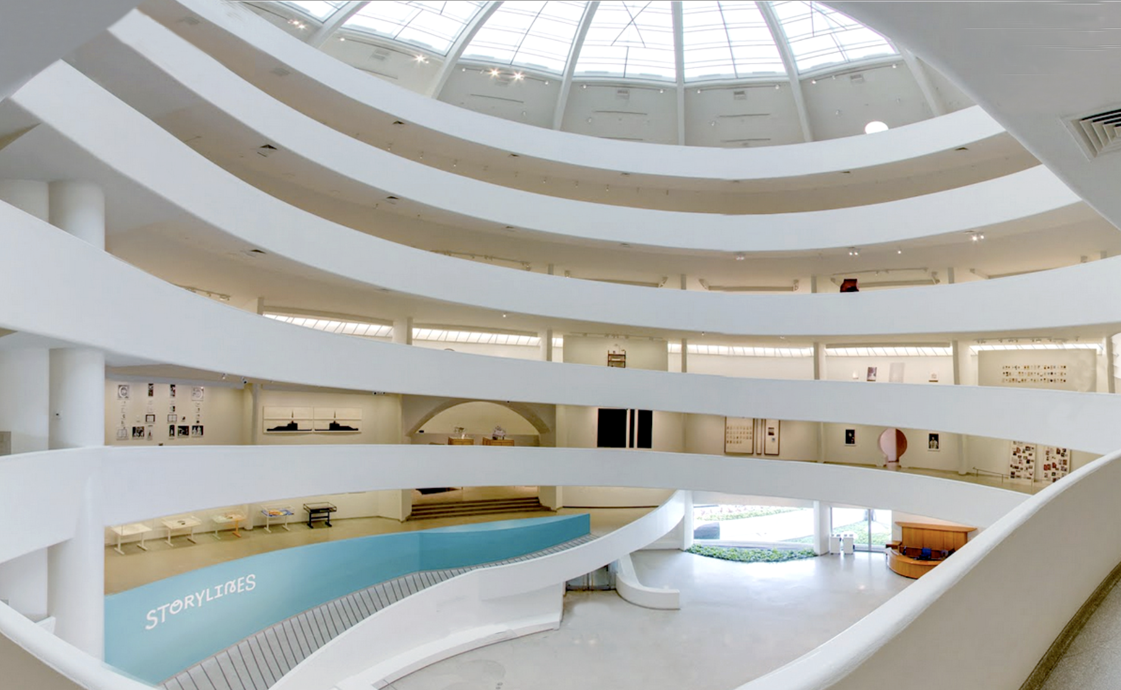

Slide 9
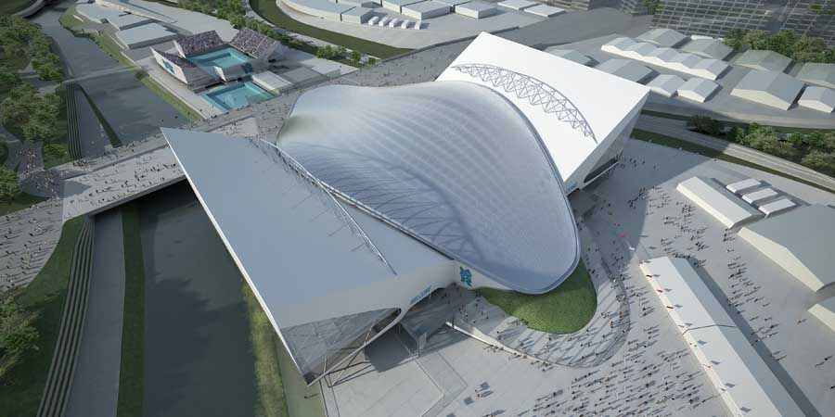

Slide 10
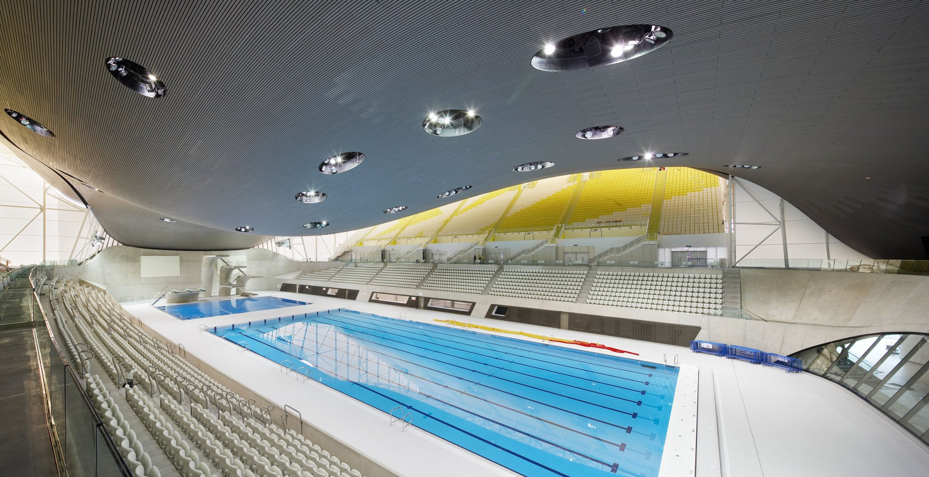

Slide 11
INTRODUCTION TO VISUAL ARTS
Workshop 2 – Sculpture
ArtWorks NYC Program 2022

Slide 12
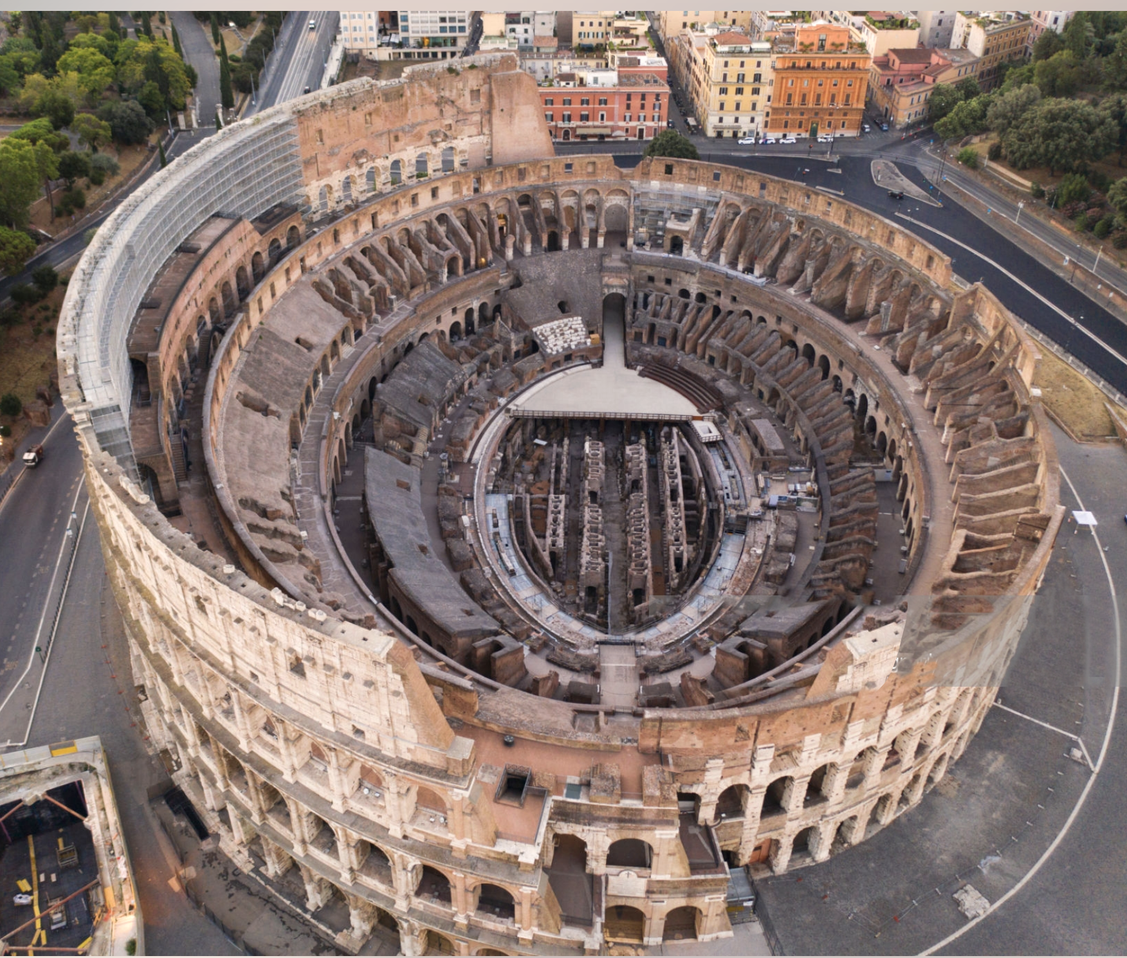
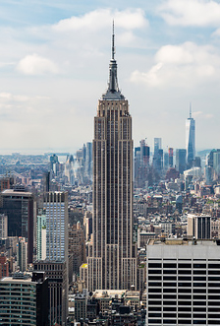
Architecture Review
1
2
3
4
5

Slide 13
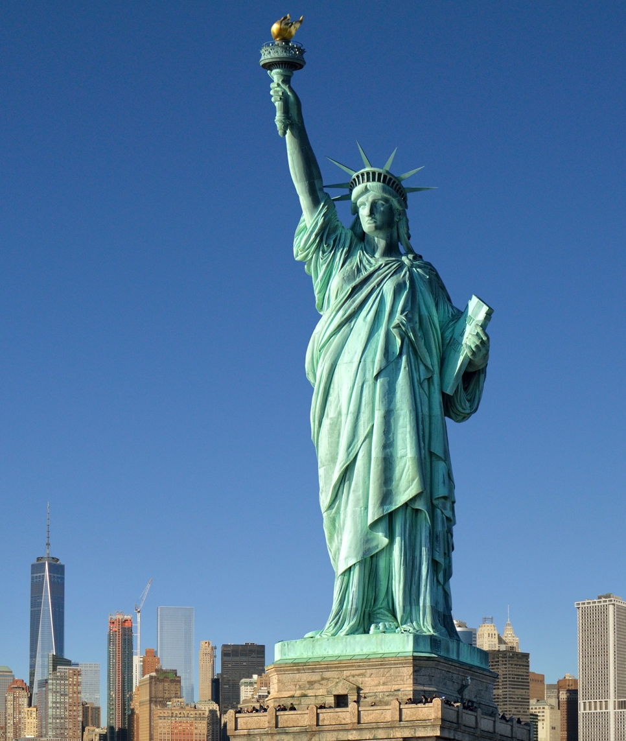

Slide 14
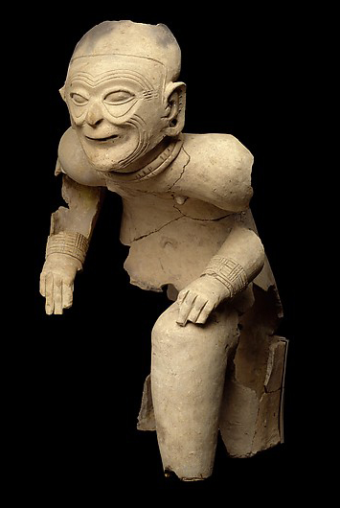

Slide 15
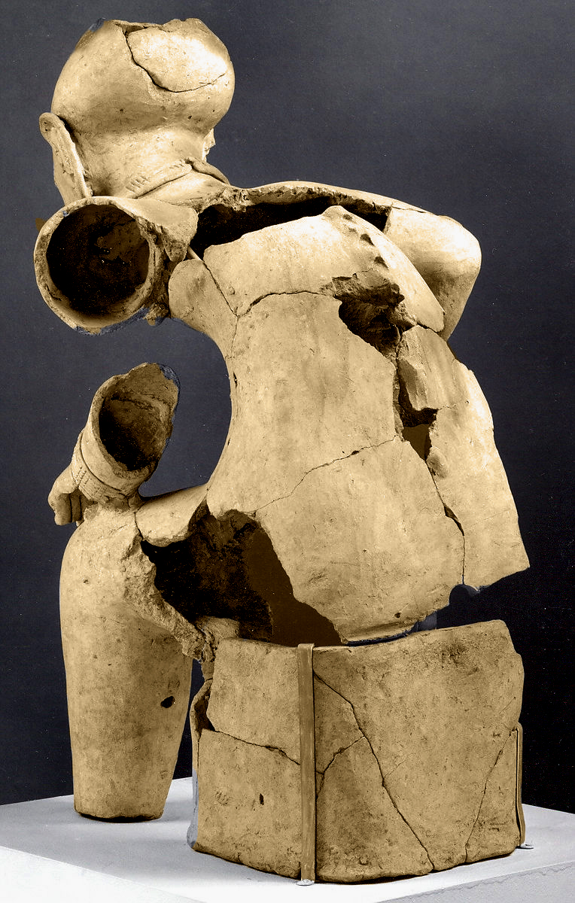

Slide 16
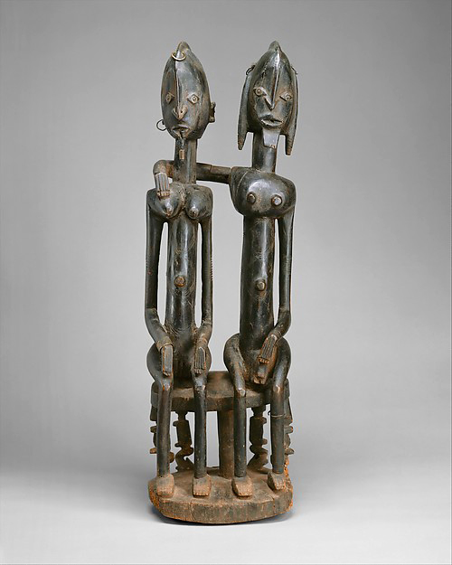

Slide 17
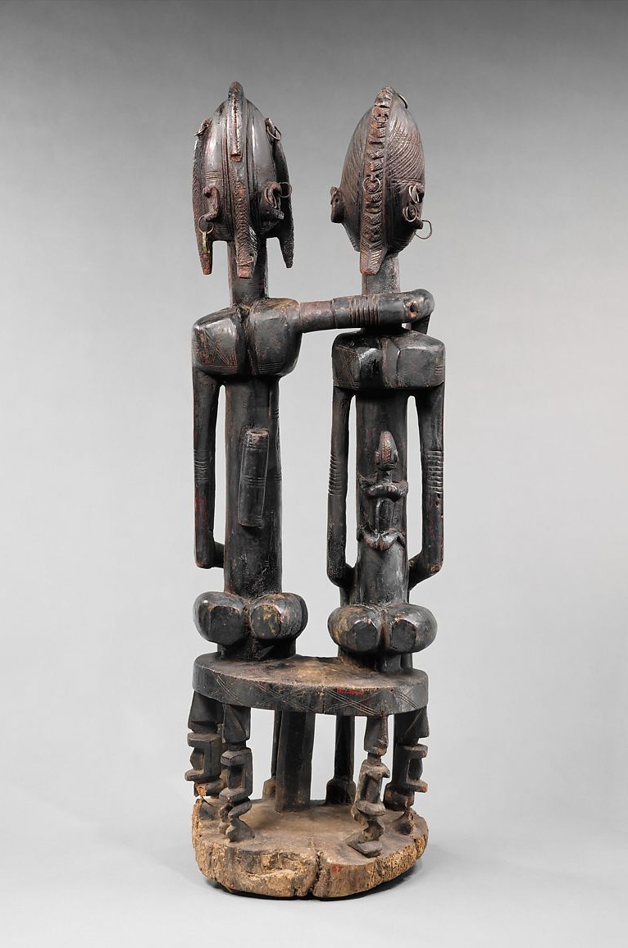

Slide 18
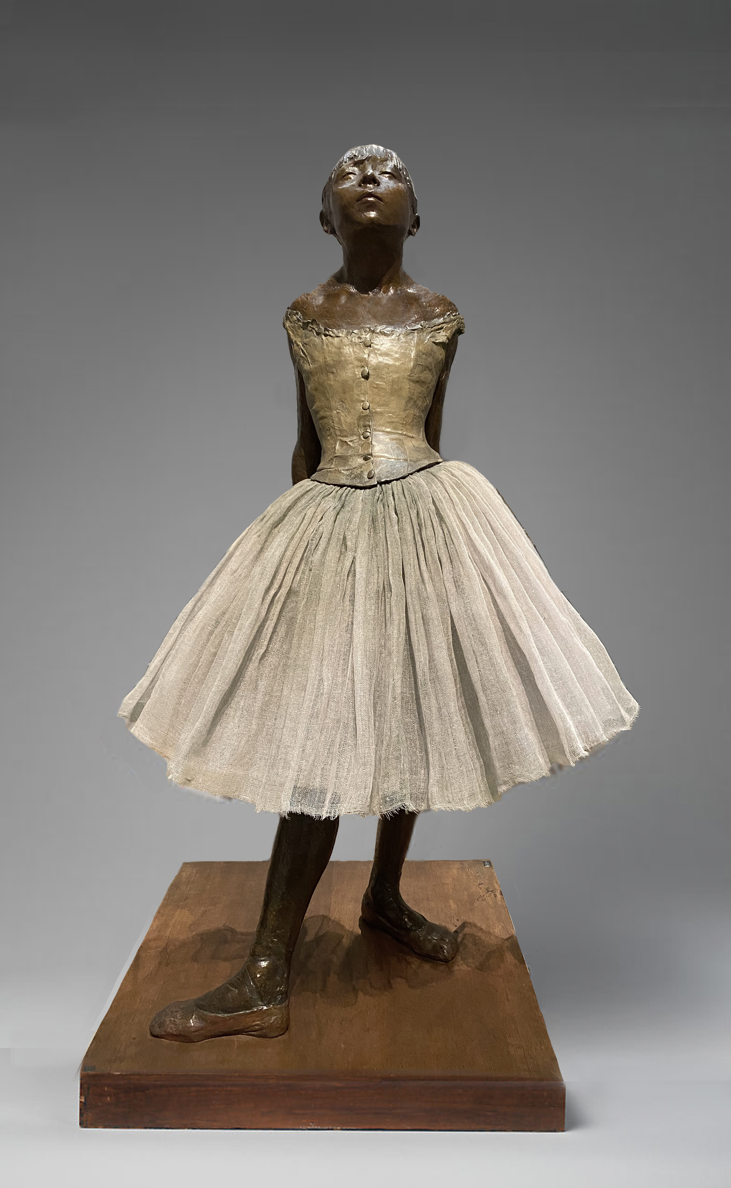

Slide 19
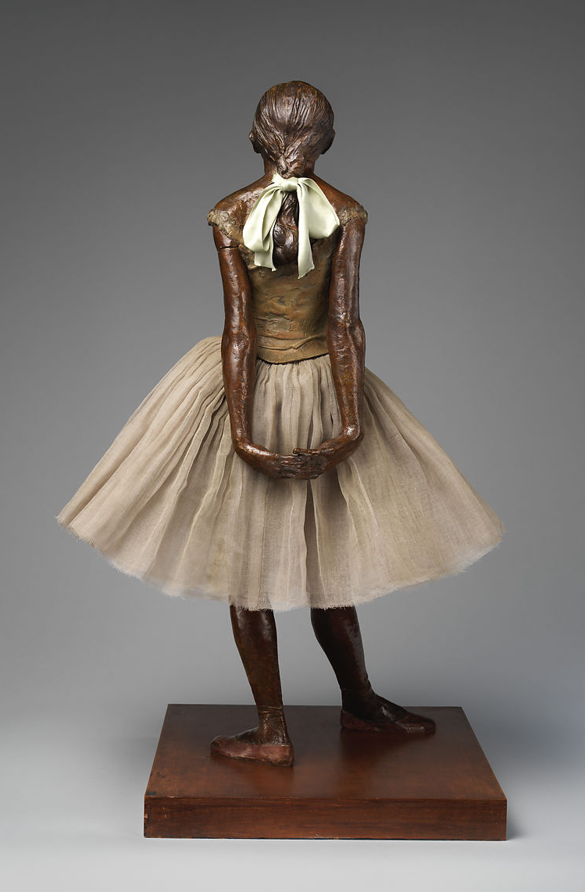

Slide 20
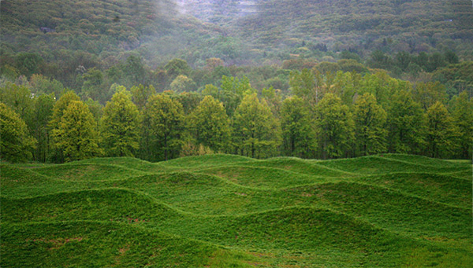

Slide 21
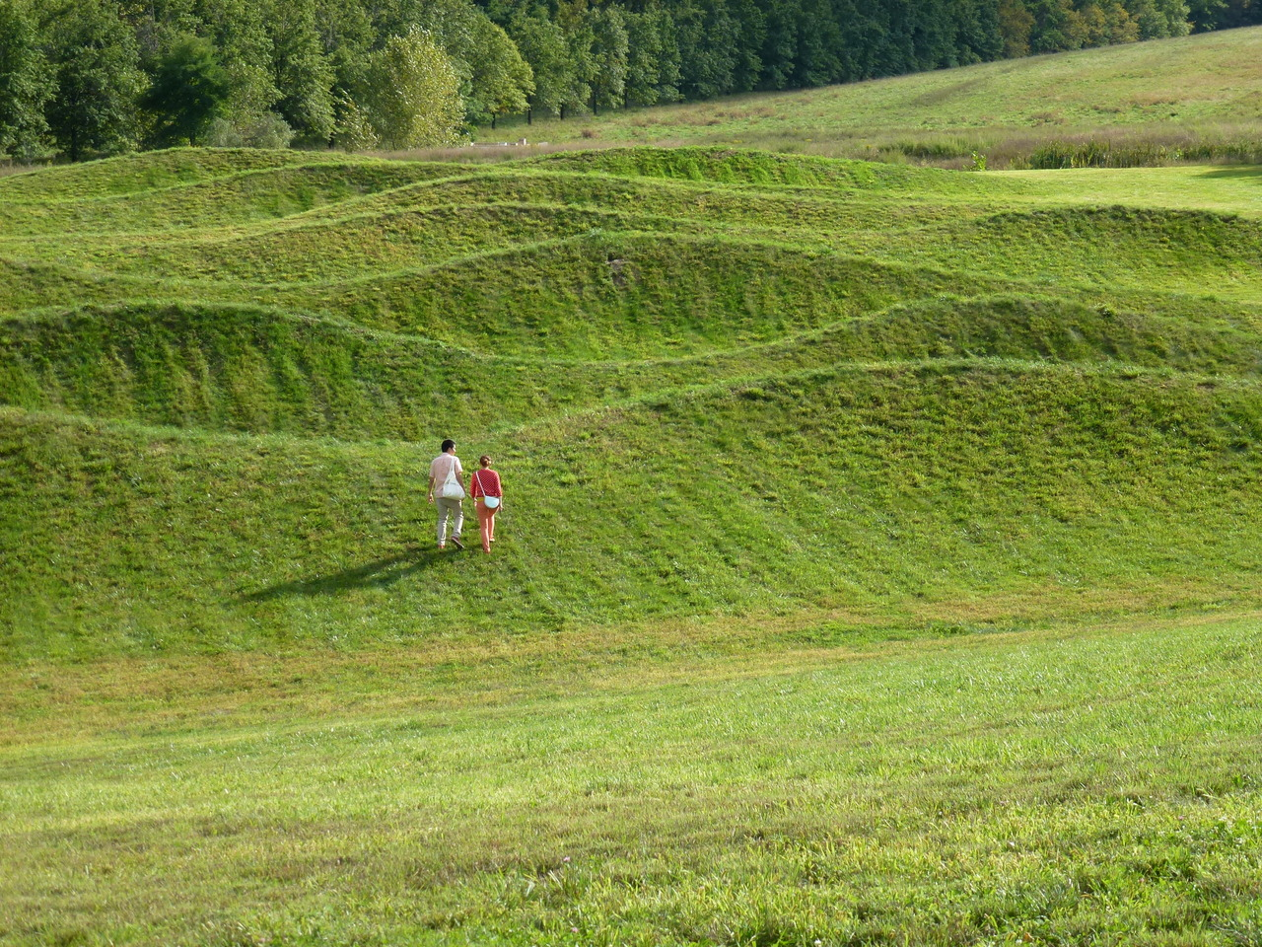

Slide 22
INTRODUCTION TO VISUAL ARTS
Workshop 3 – Painting
ArtWorks NYC Program 2022

Slide 23
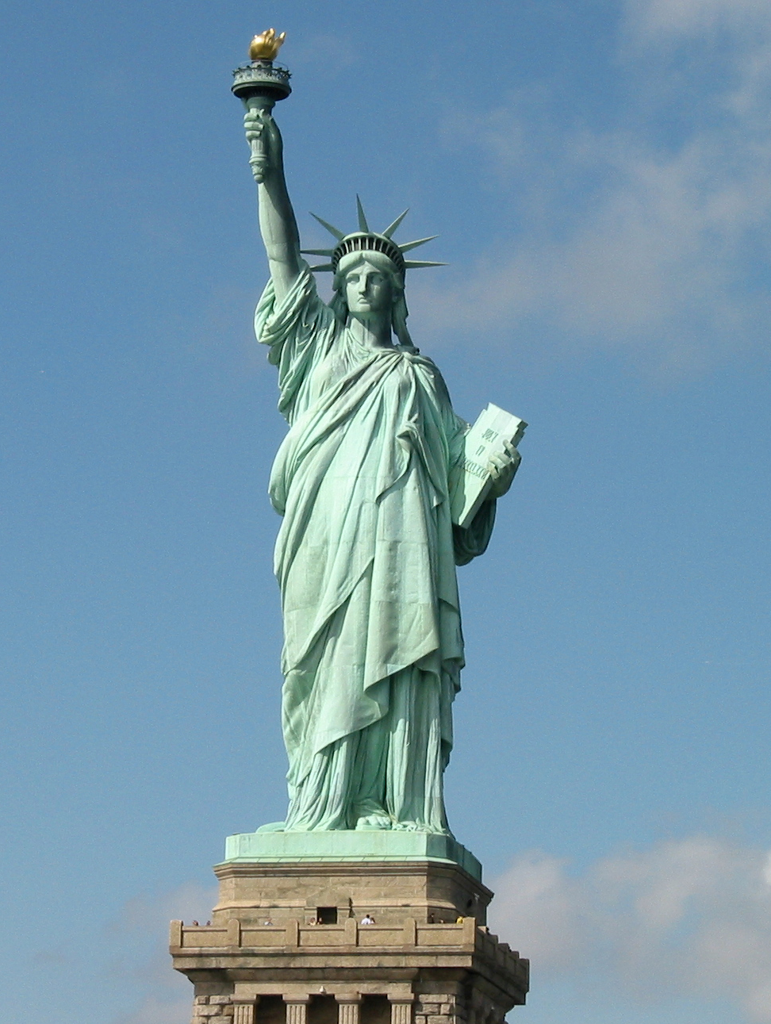
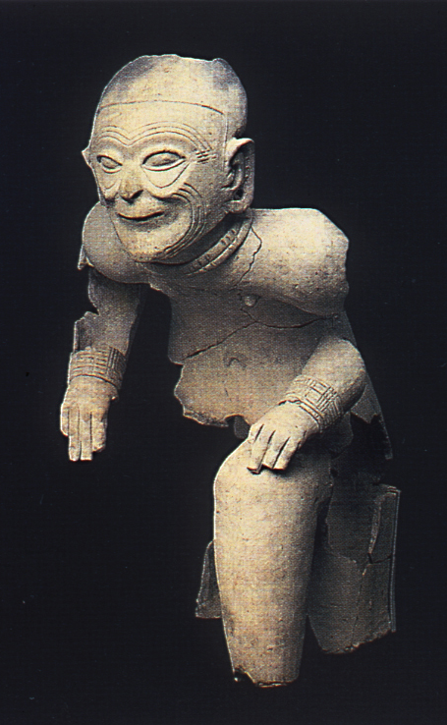
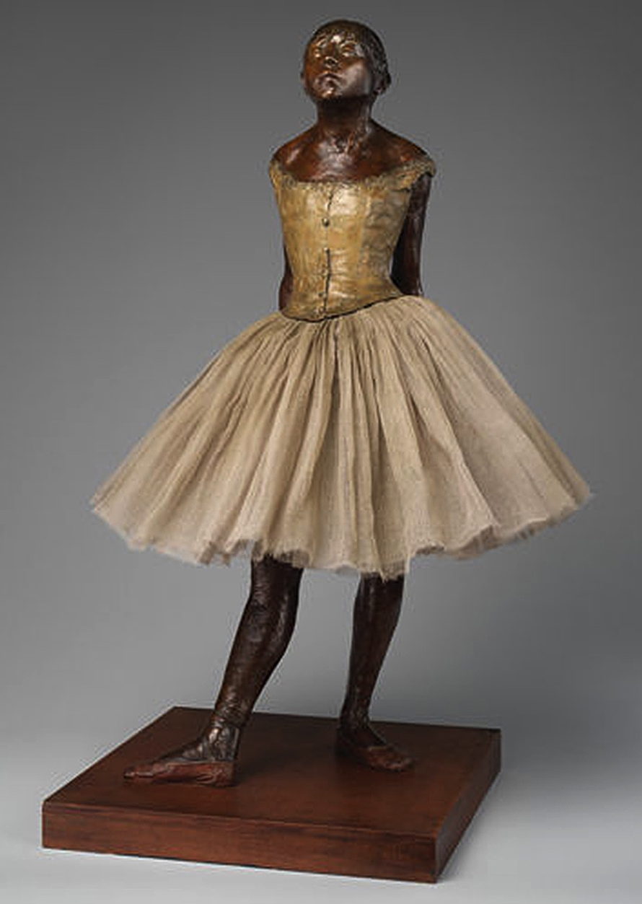
1
2
3
Sculpture Review
4
5

Slide 24
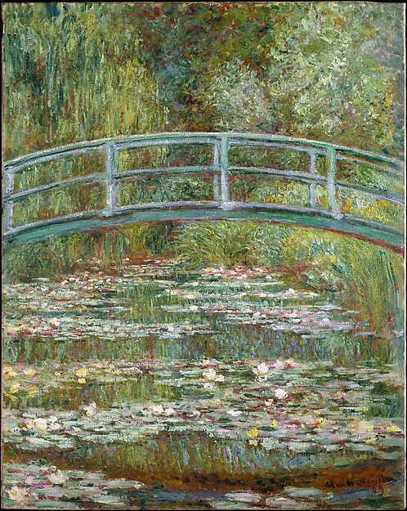

Slide 25
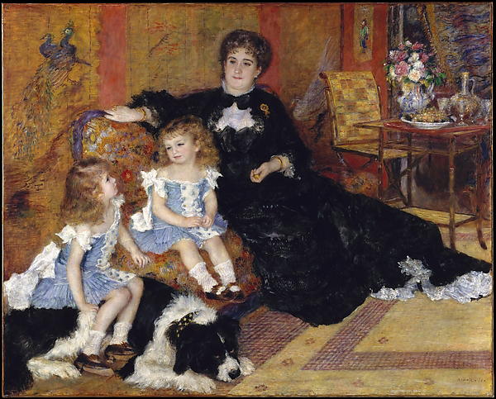

Slide 26
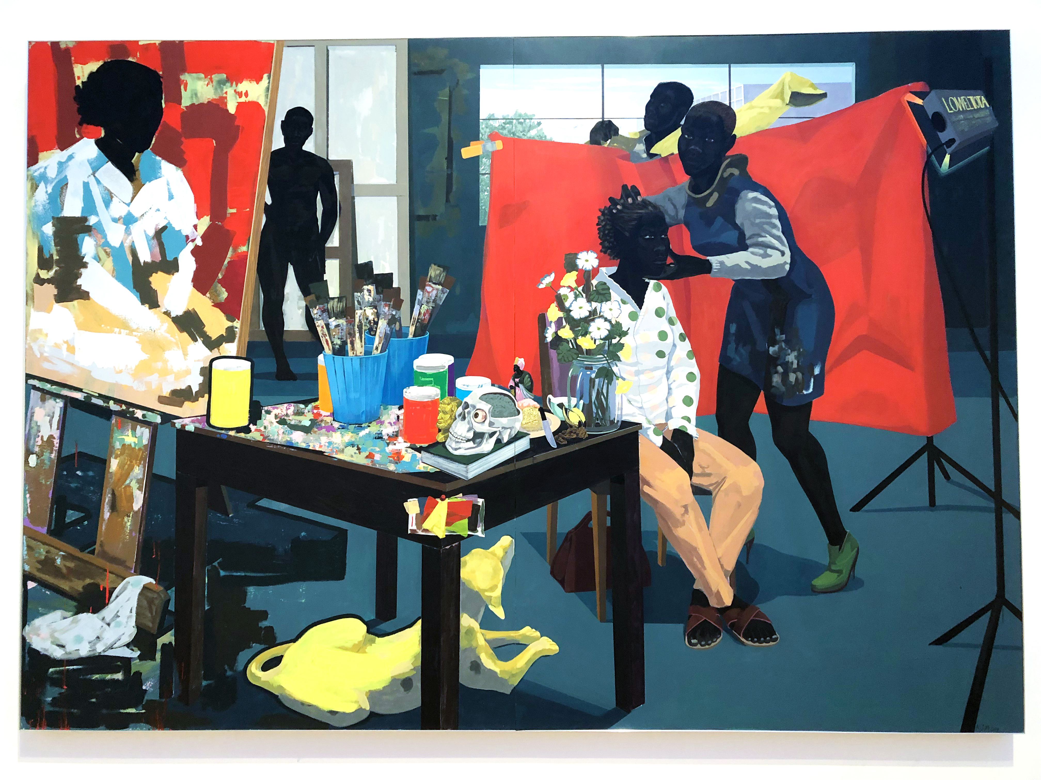

Slide 27
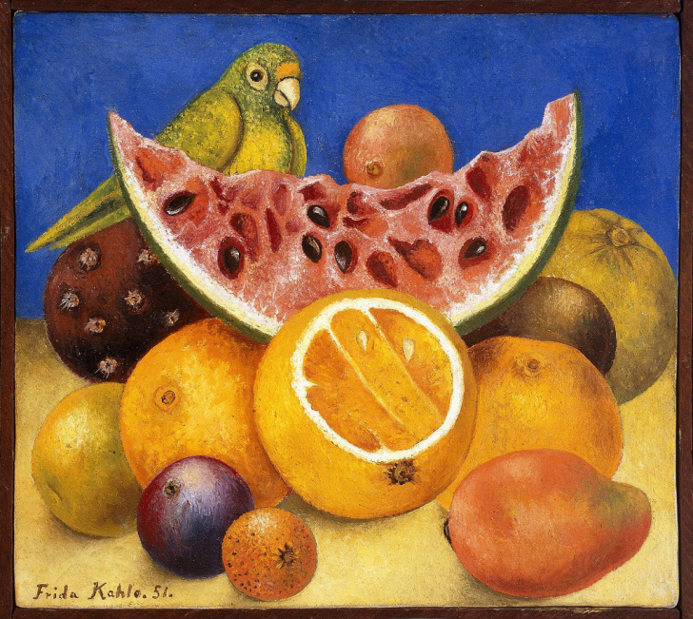

Slide 28
The Great Figure Five
By William Carlos Williams
Among the rain
and lights
I saw the figure 5
in gold
on a red
firetruck
moving
tense
unheeded
to gong clangs
siren howls
and wheels rumbling
through the dark city

Slide 29
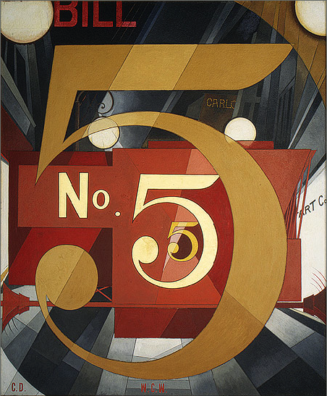

Slide 30
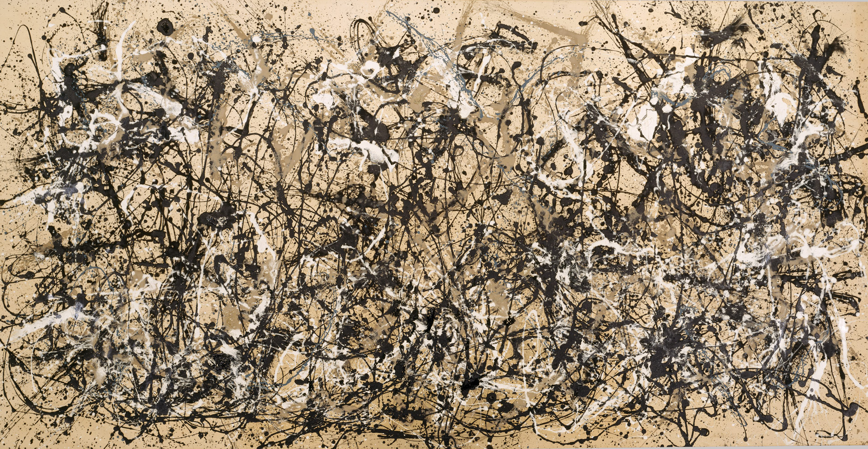

Slide 31
INTRODUCTION TO VISUAL ARTS
Workshop 4 – Decorative Art
ArtWorks NYC Program 2022

Slide 32
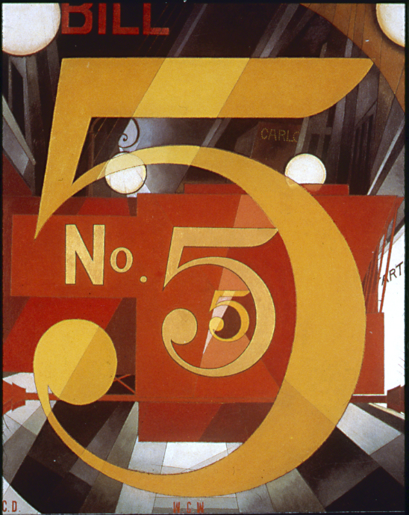
Painting Review
1
3
2
5
4
5
6

Slide 33
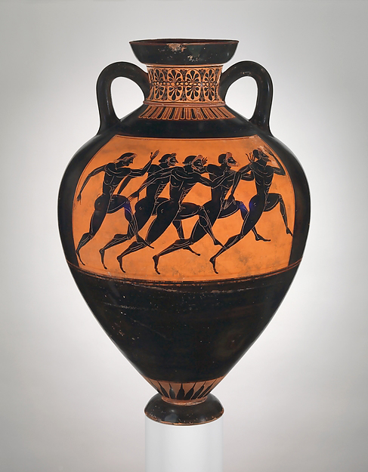

Slide 34
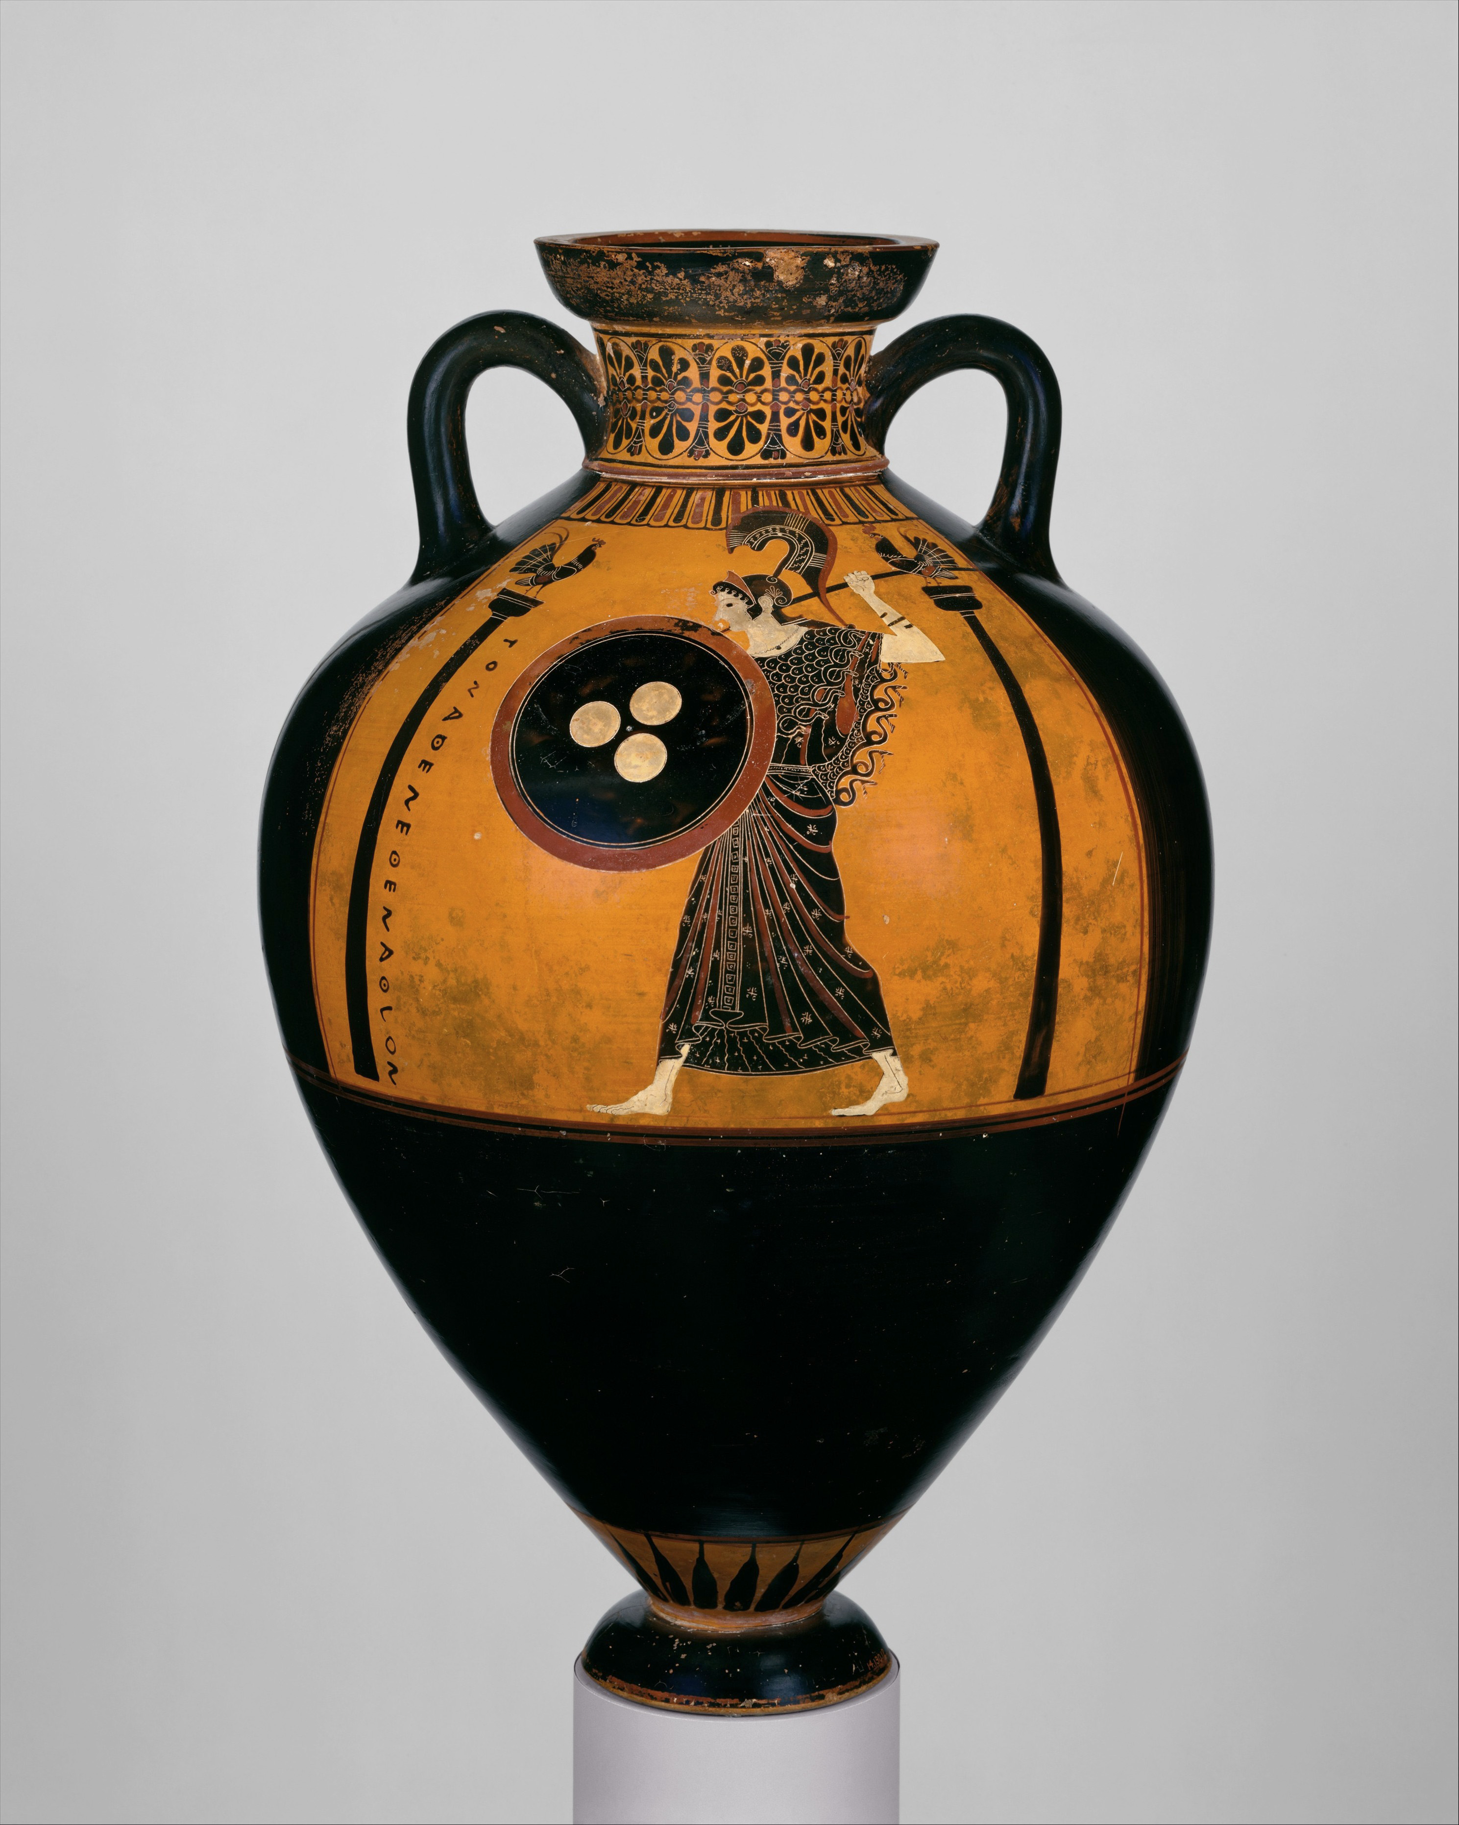

Slide 35
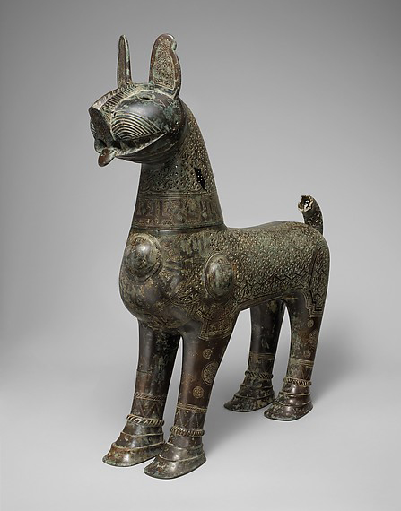

Slide 36
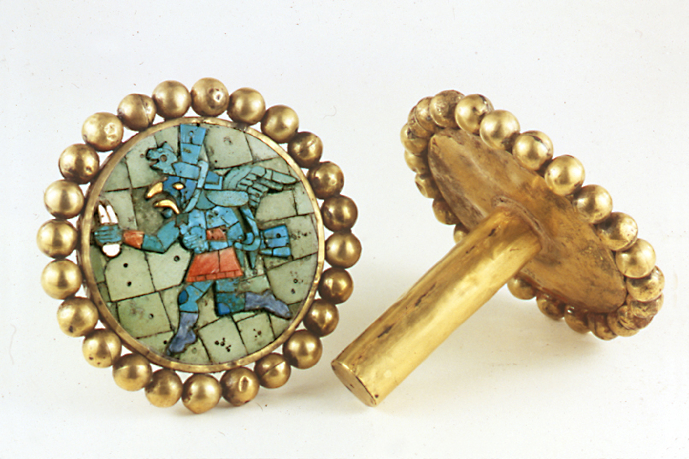

Slide 37
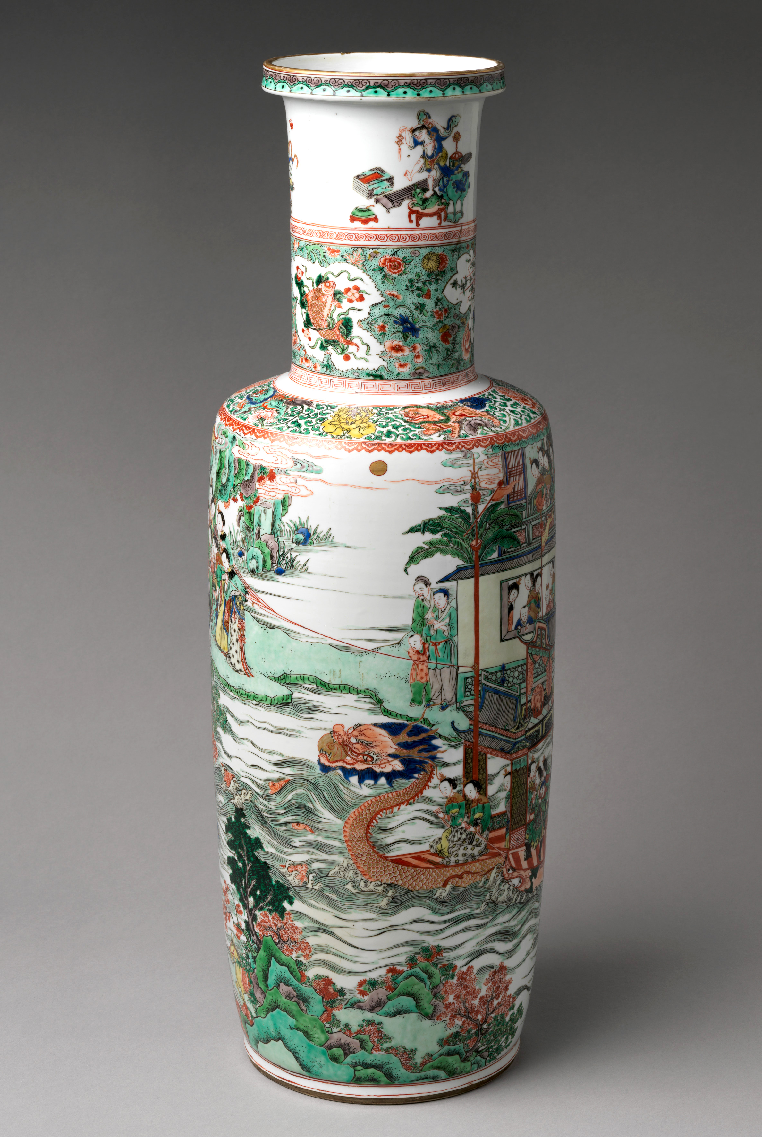

Slide 38
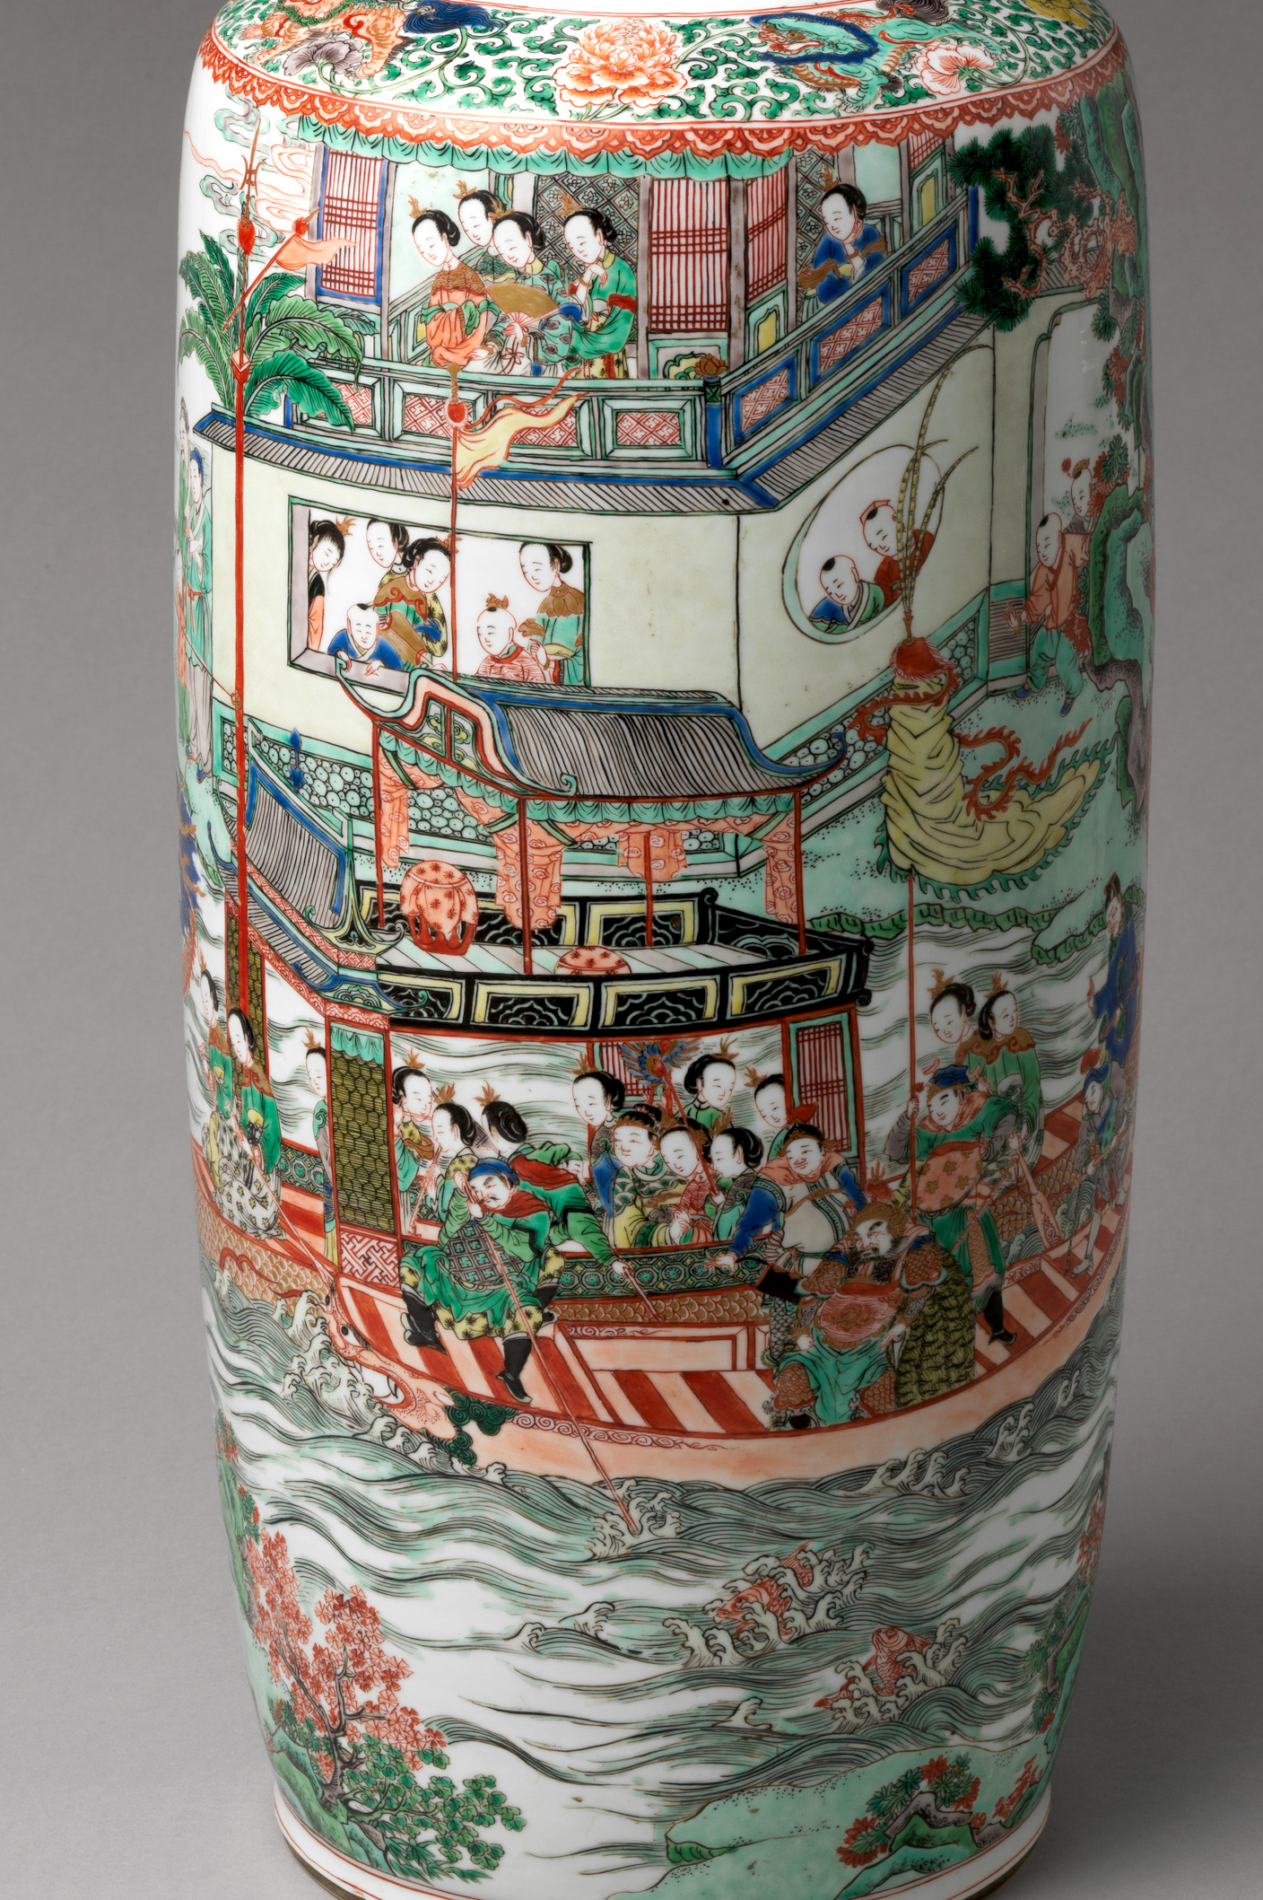

Slide 39
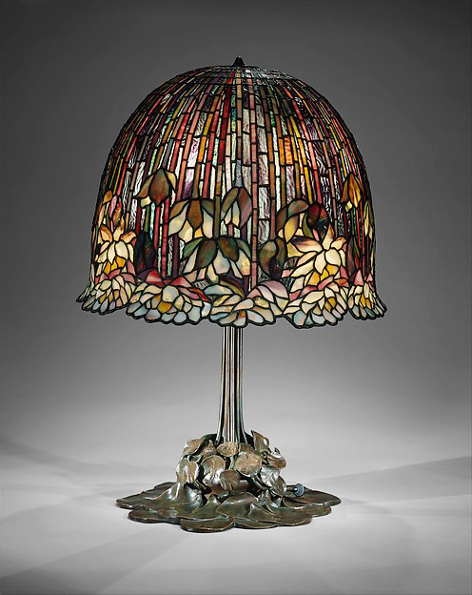

Slide 40
