Slide 1

EARLY AMERICAN ART
Workshop 1
Native American and Colonial American
ArtWorks NYC
Brooklyn 4th Grade Program 2026

Slide 2
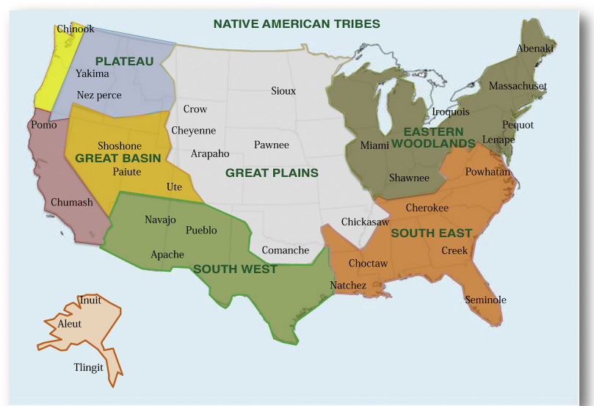

Slide 3
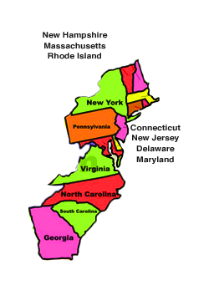
Colonial America
The first 13 colonies 1607-1732

Slide 4
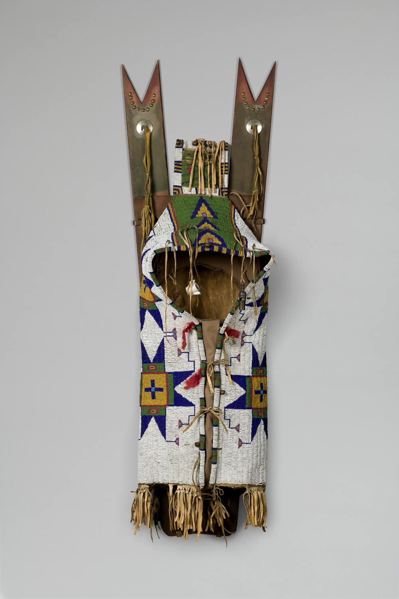

Slide 5
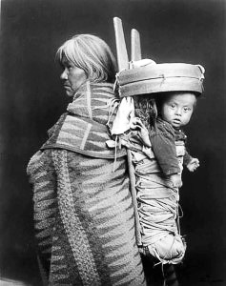
Navaho cradleboards had wide curved hoop protecting the baby’s head.

Slide 6
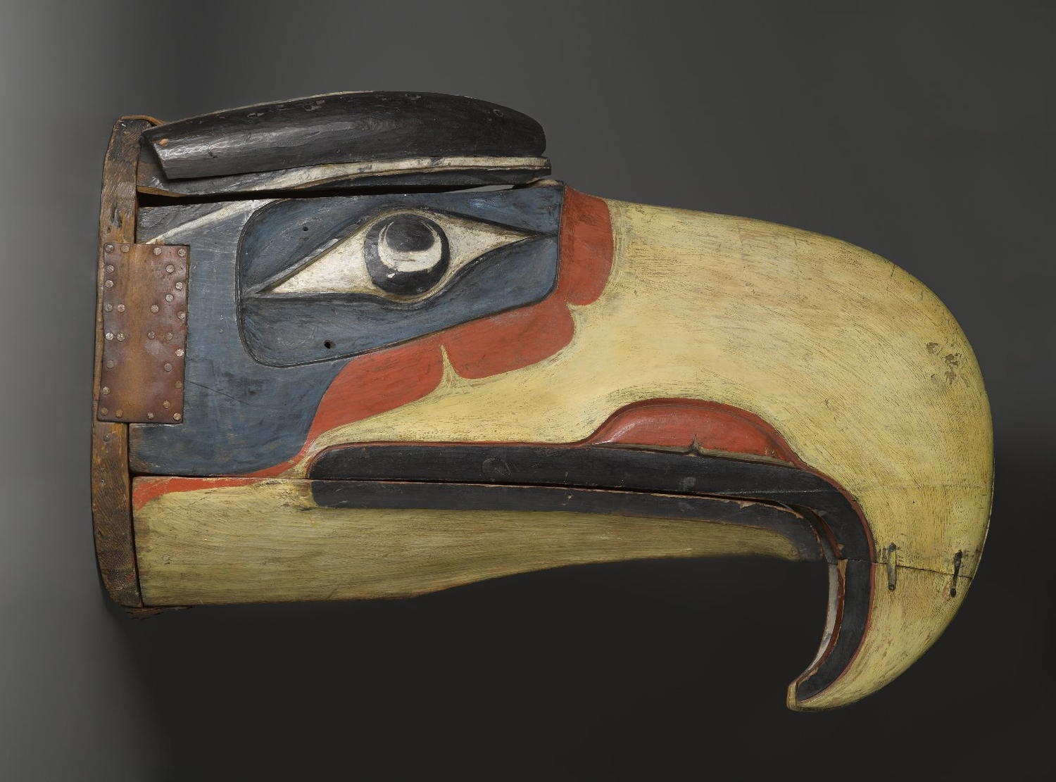

Slide 7
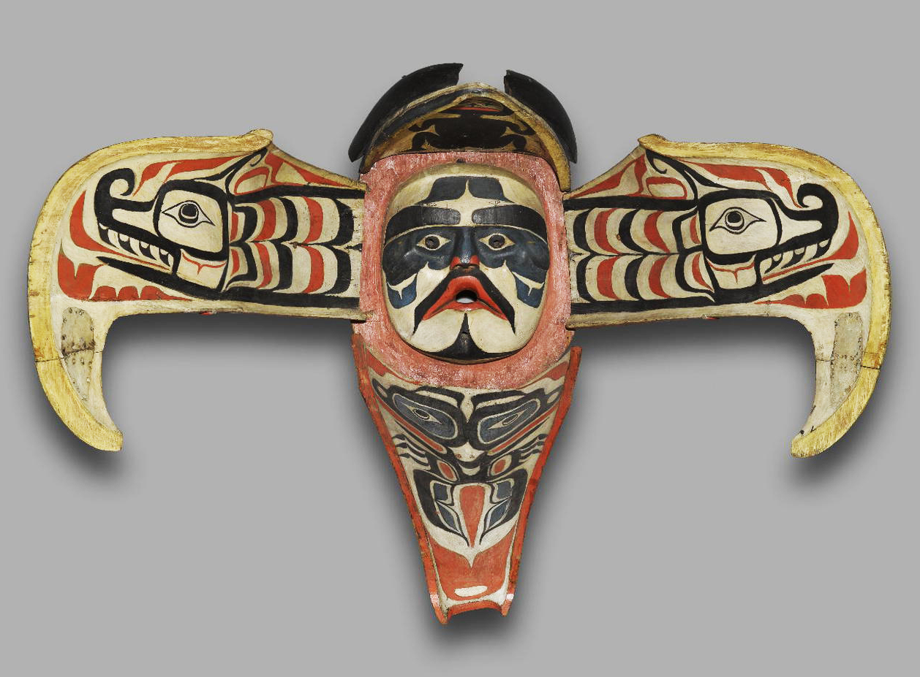

Slide 8
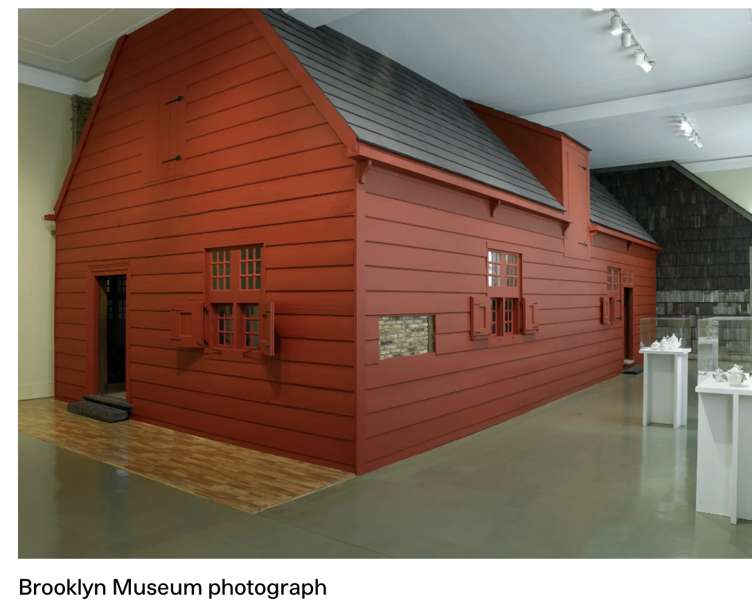

Slide 9
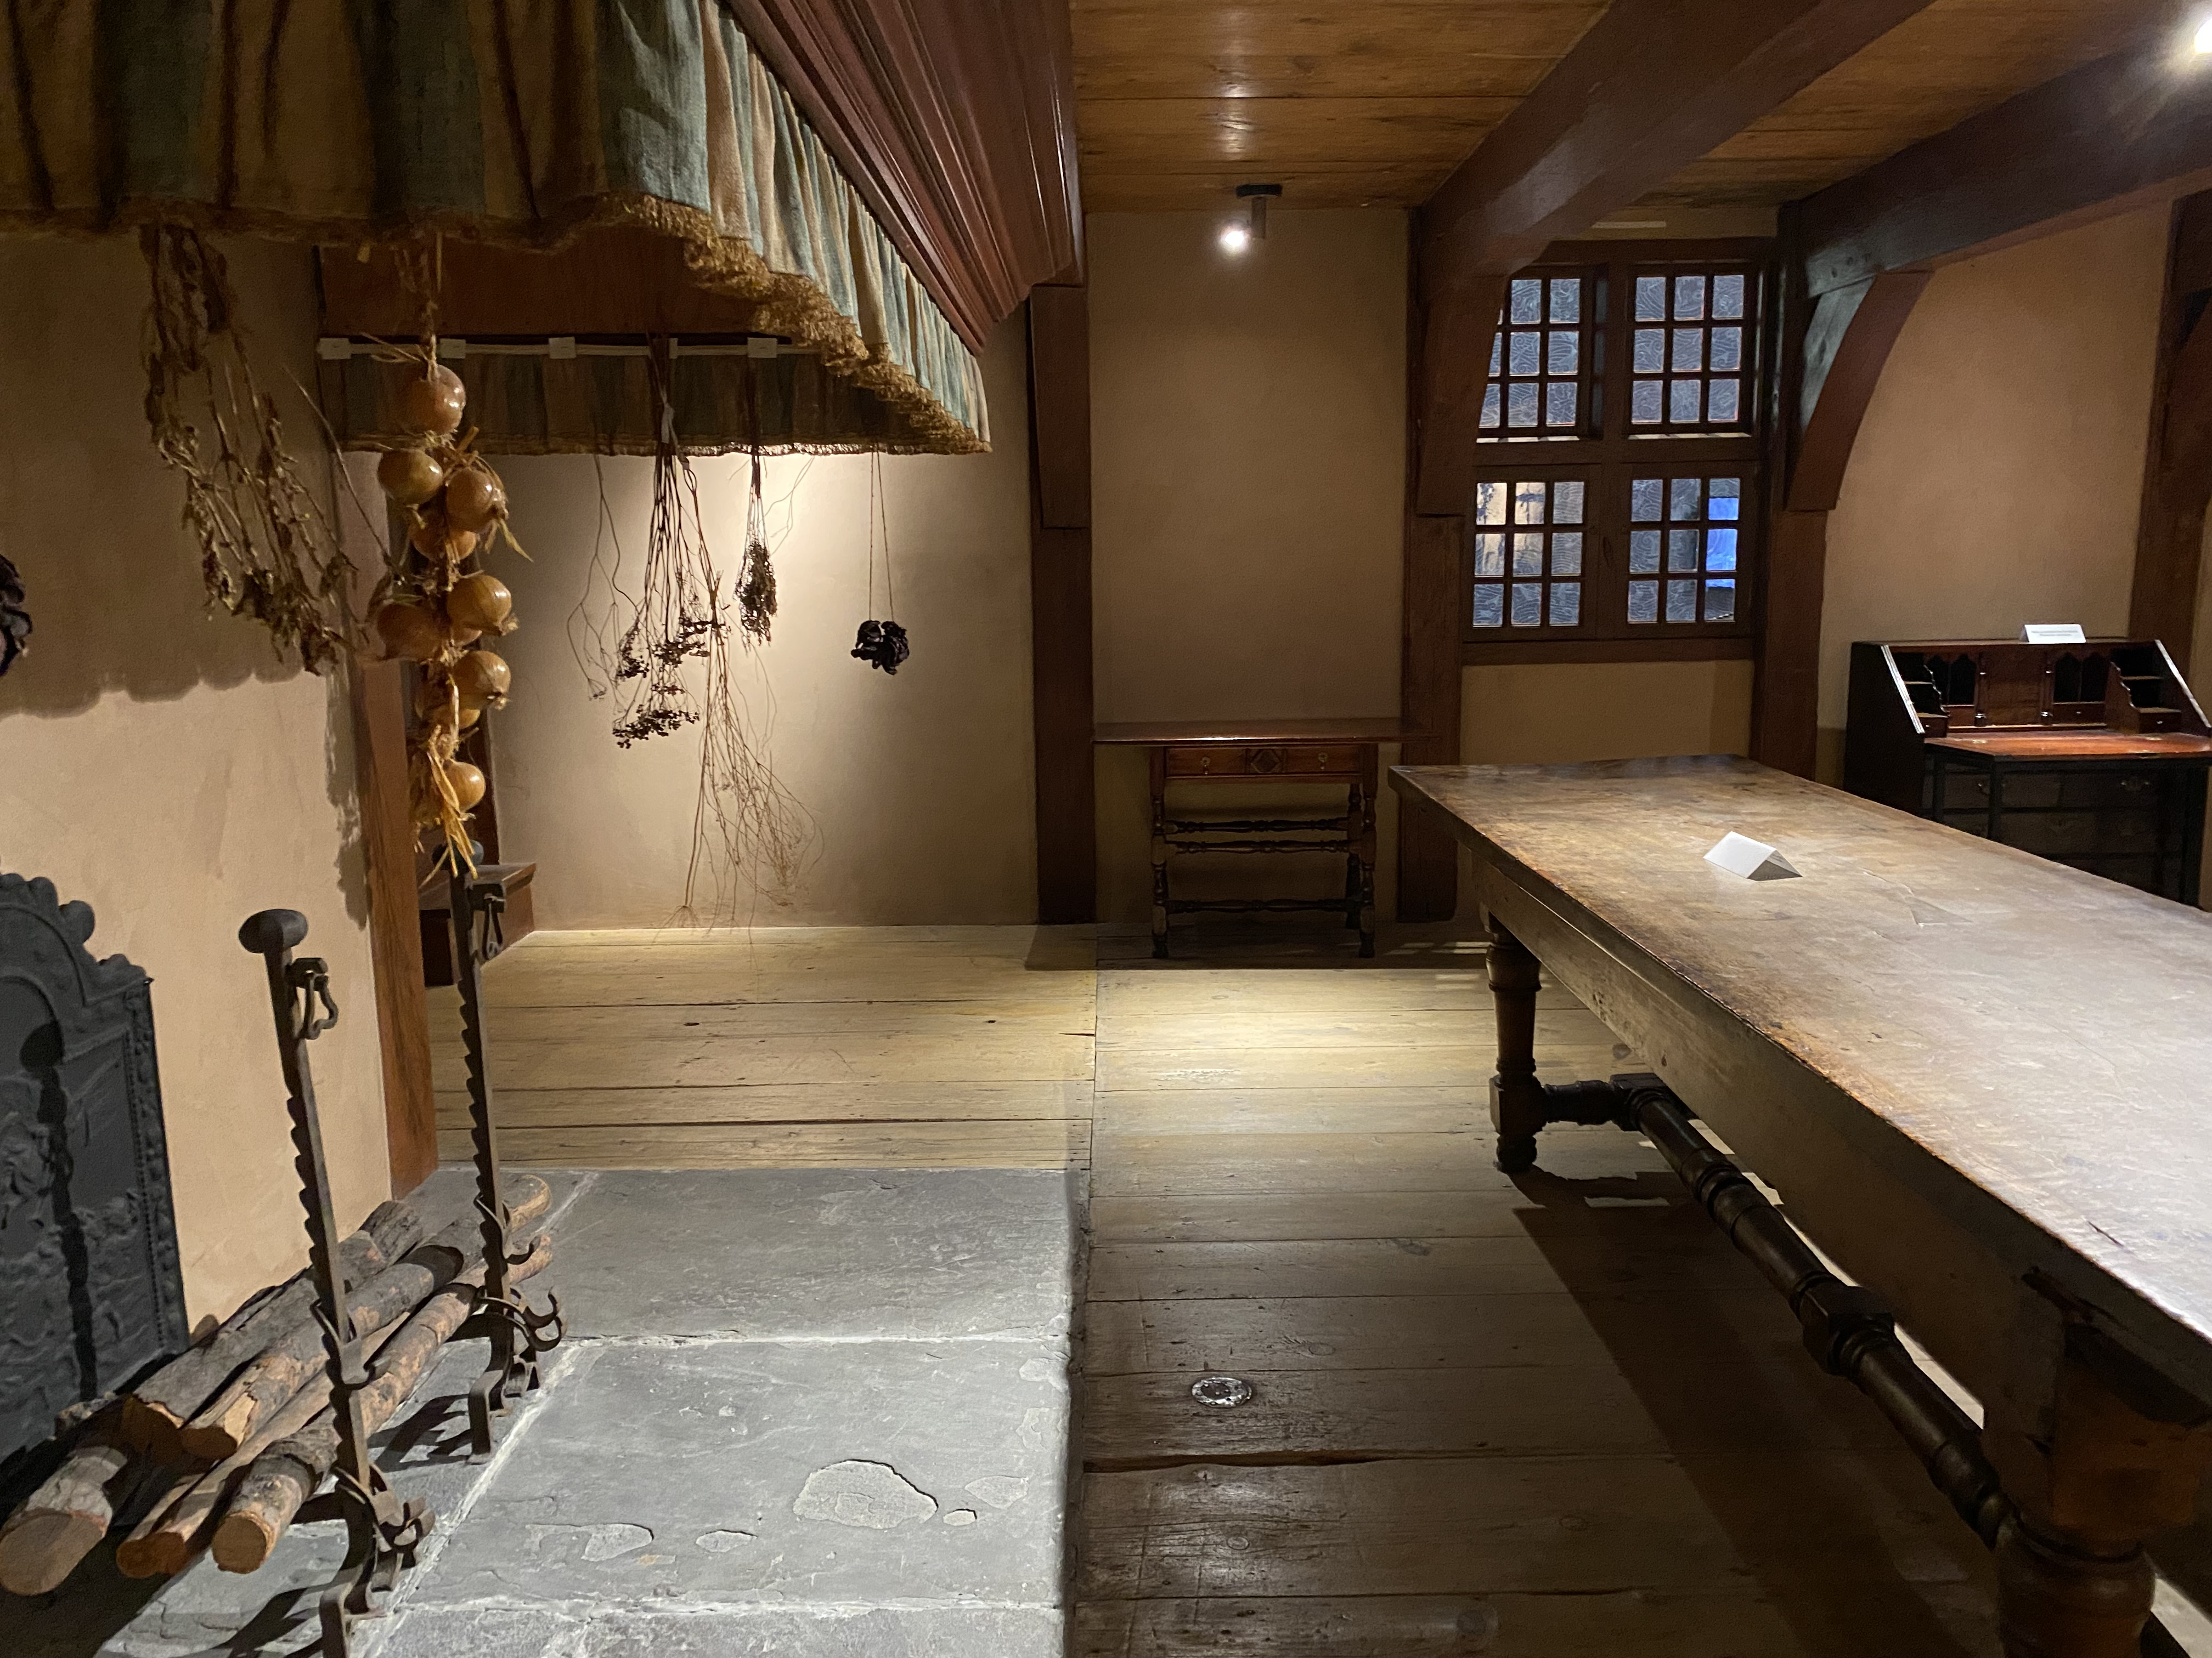
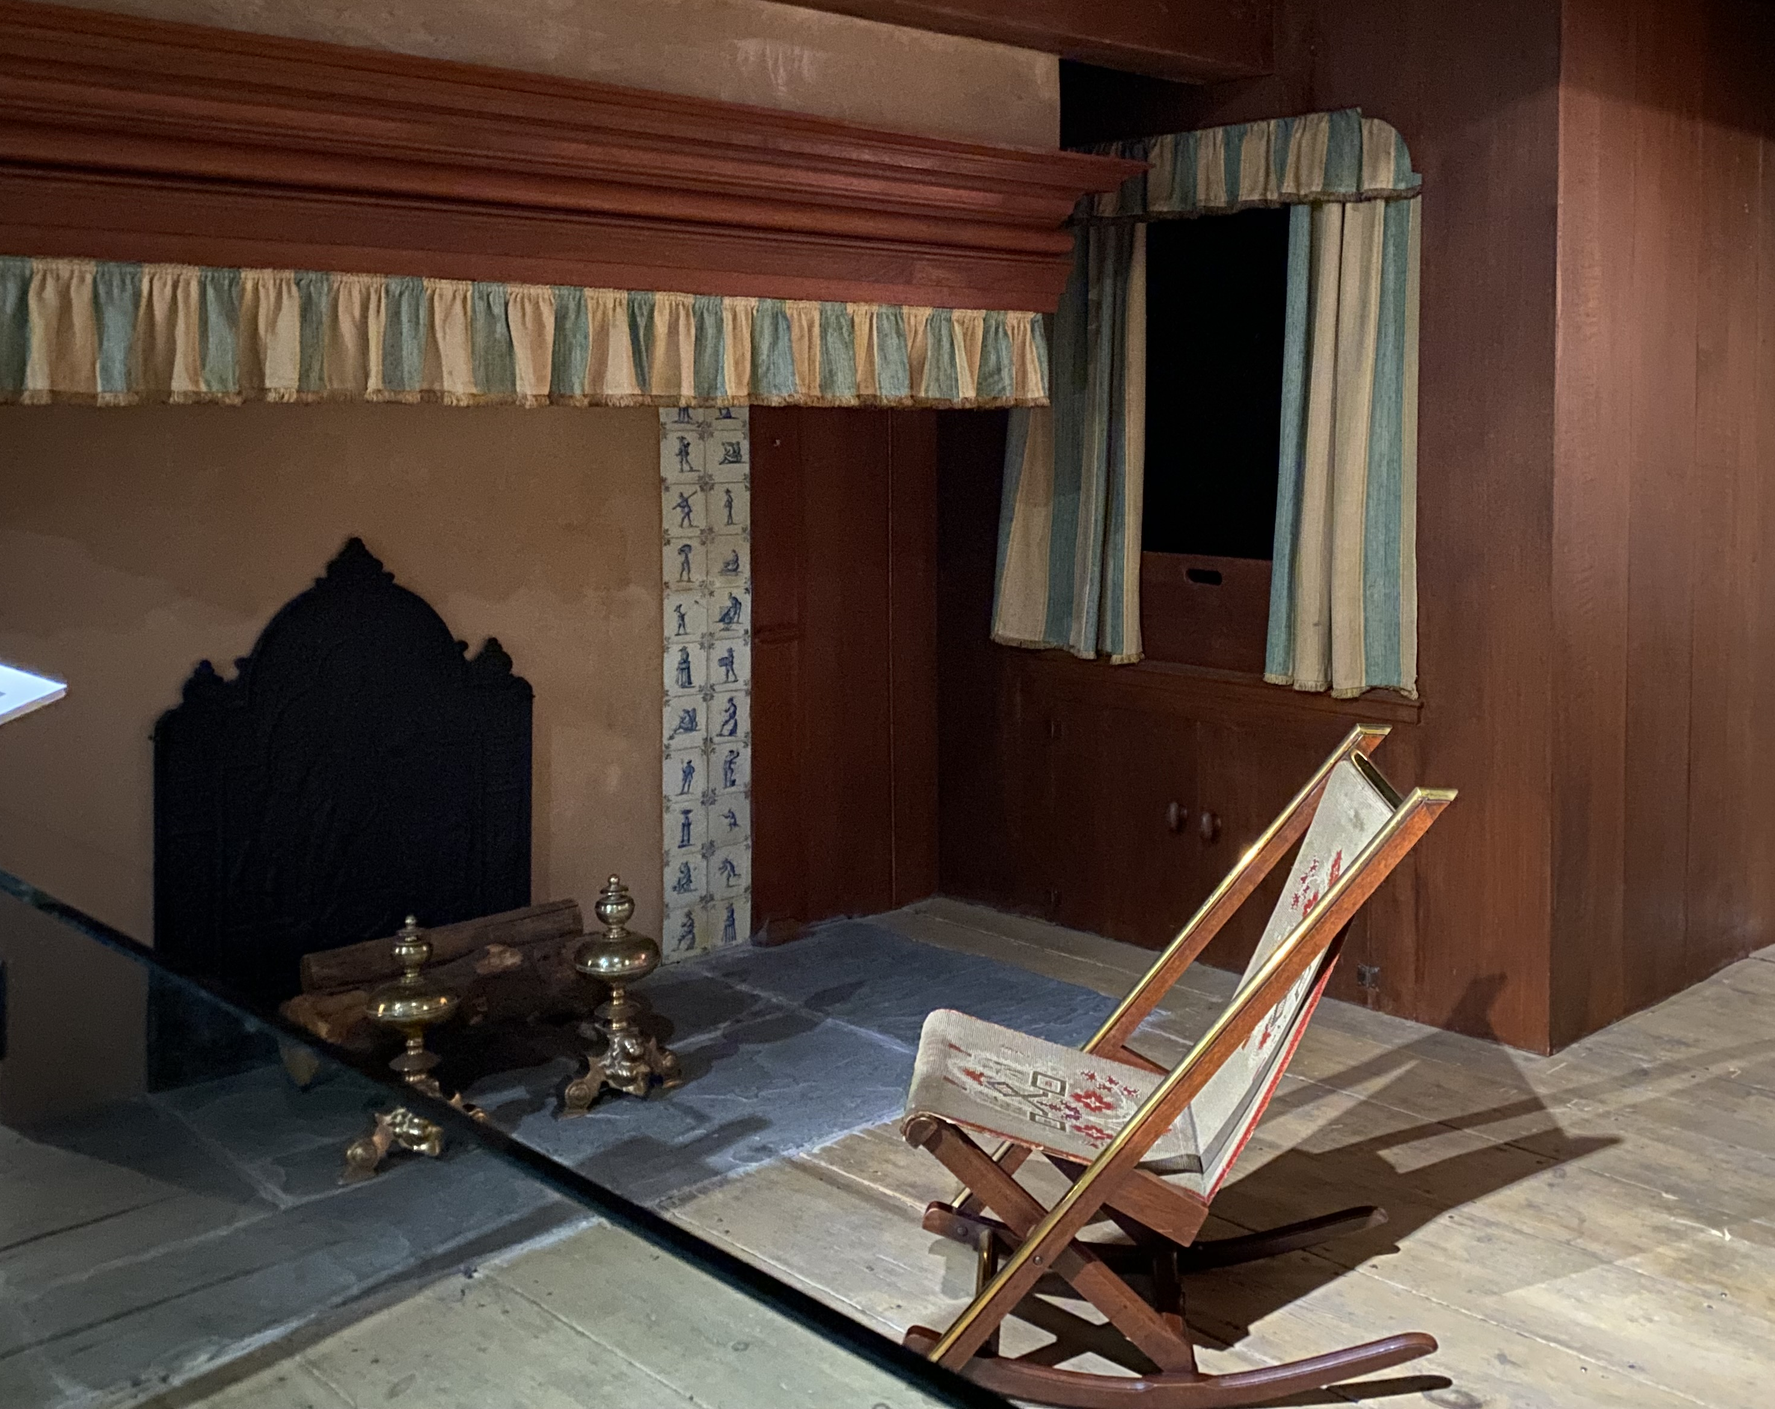

Slide 10
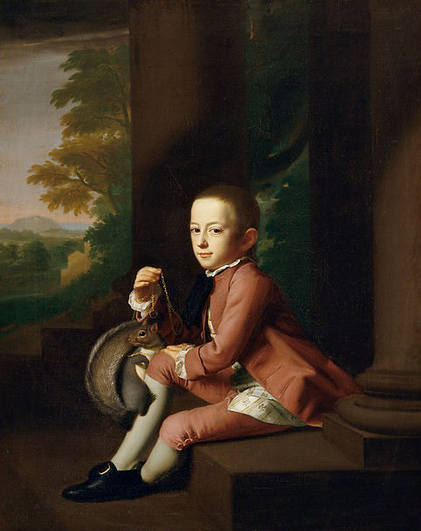

Slide 11
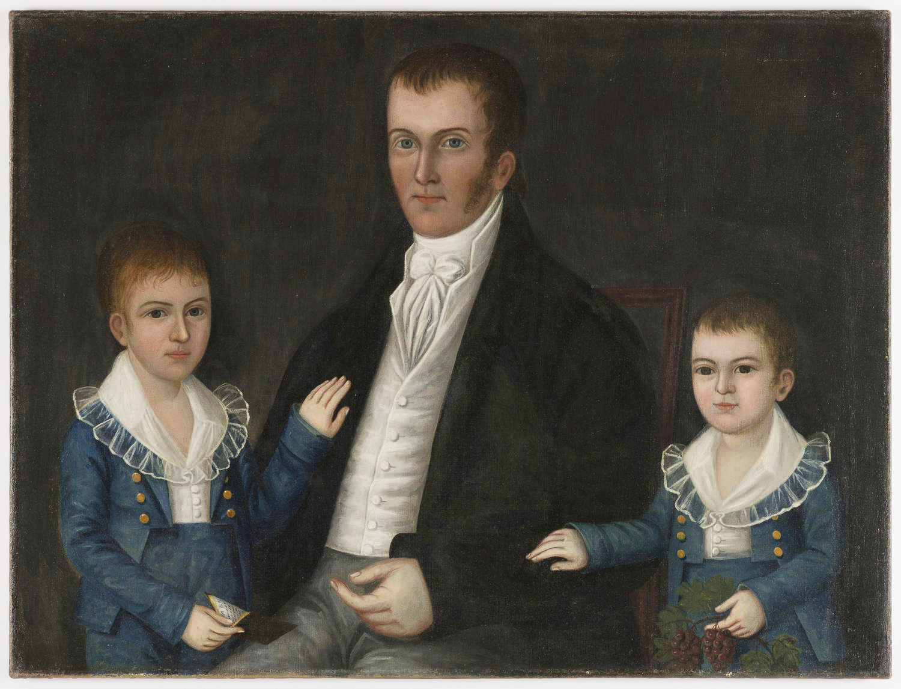

Slide 12
EARLY AMERICAN ART
Workshop 2
The American Revolution
ArtWorks NYC
Brooklyn 4th Grade Program 2026

Slide 13
Native American and Colonial Art Review

Slide 14
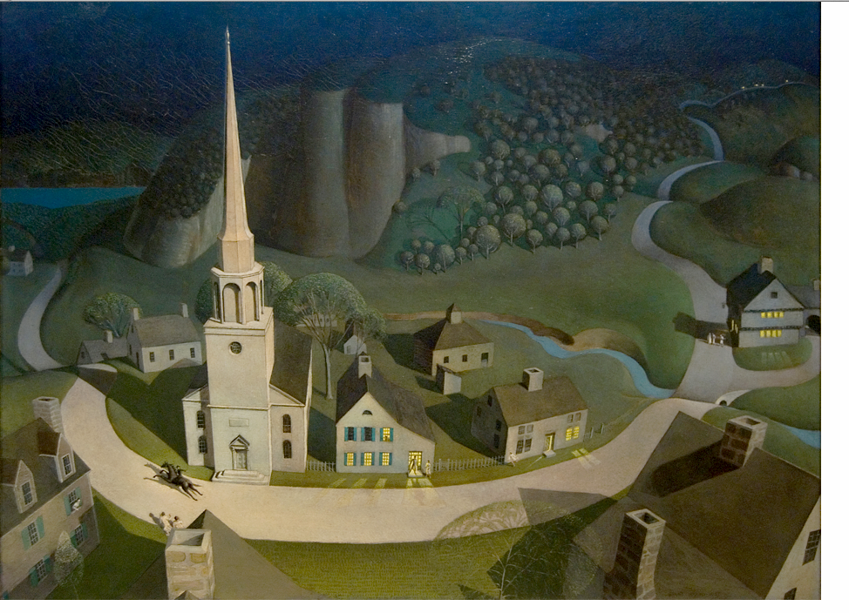

Slide 15
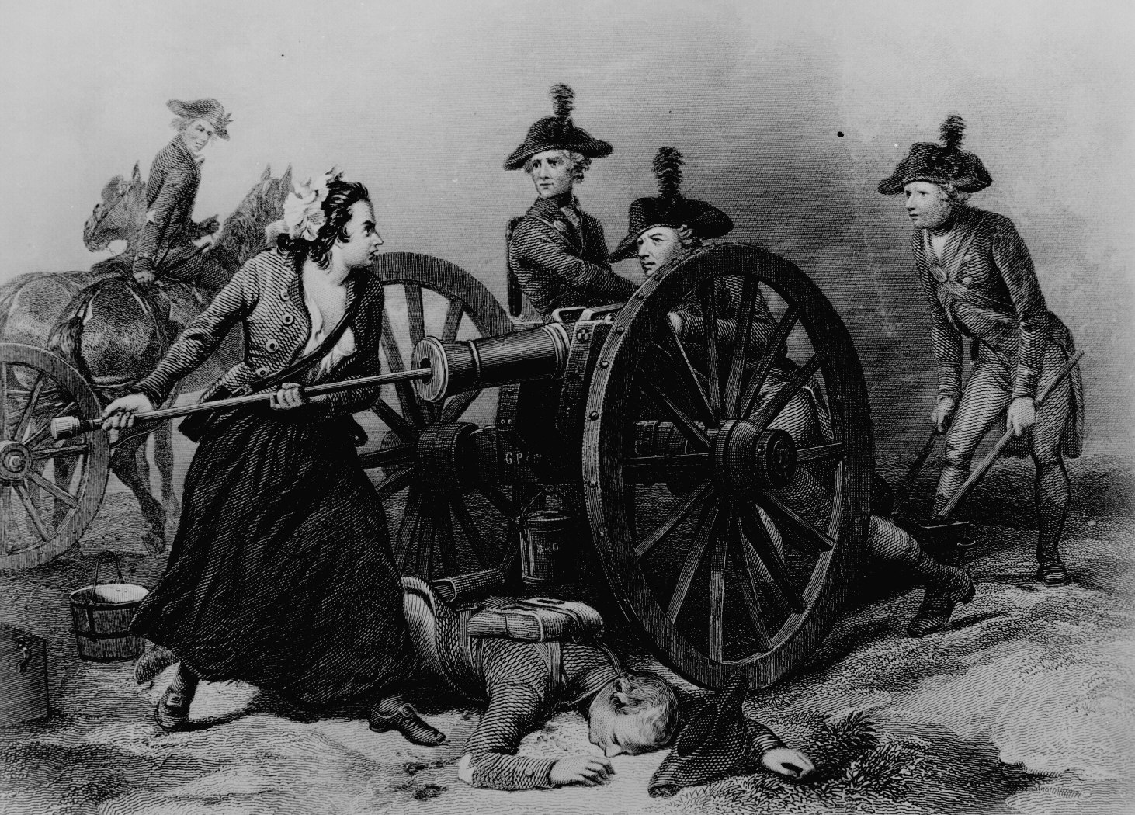

Slide 16
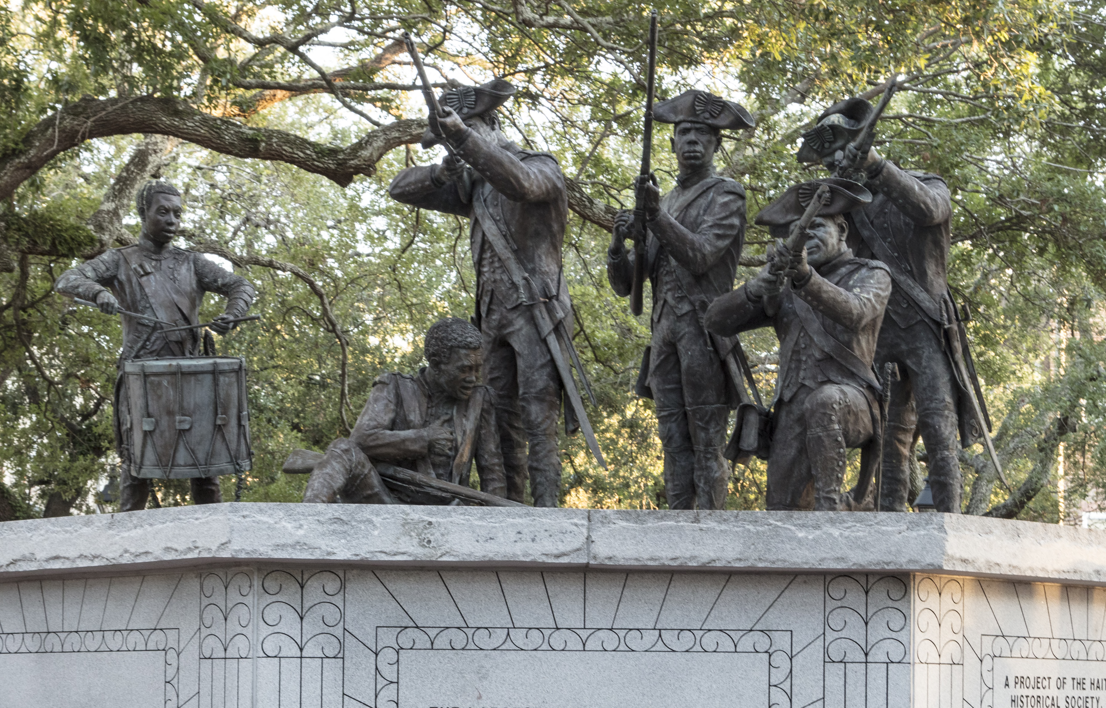

Slide 17
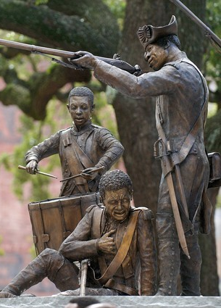
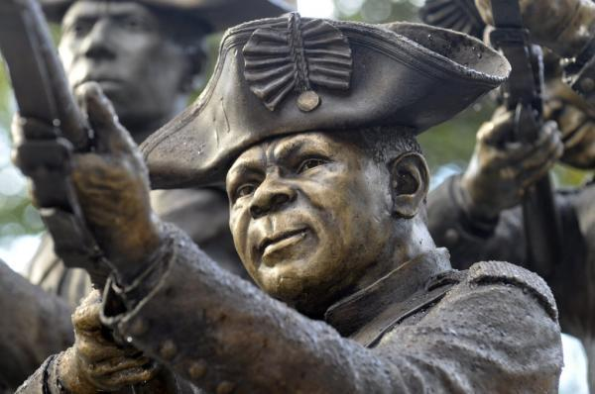

Slide 18
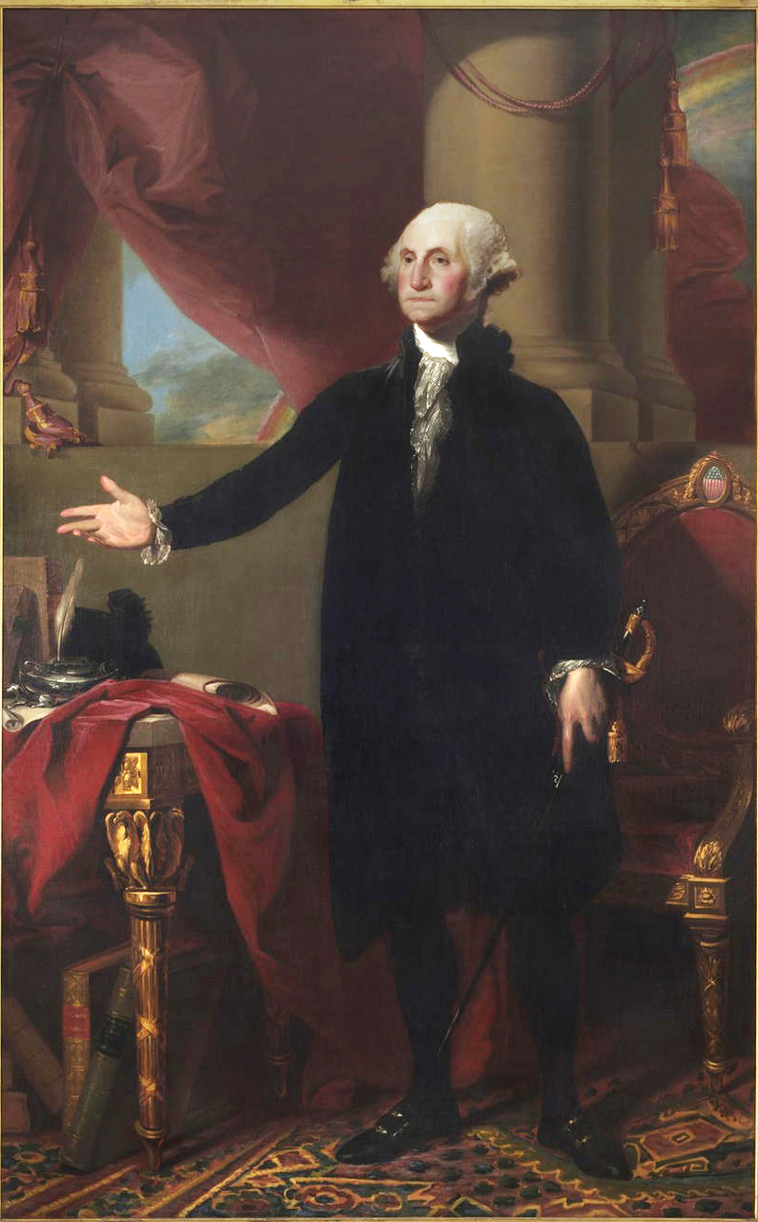

Slide 19
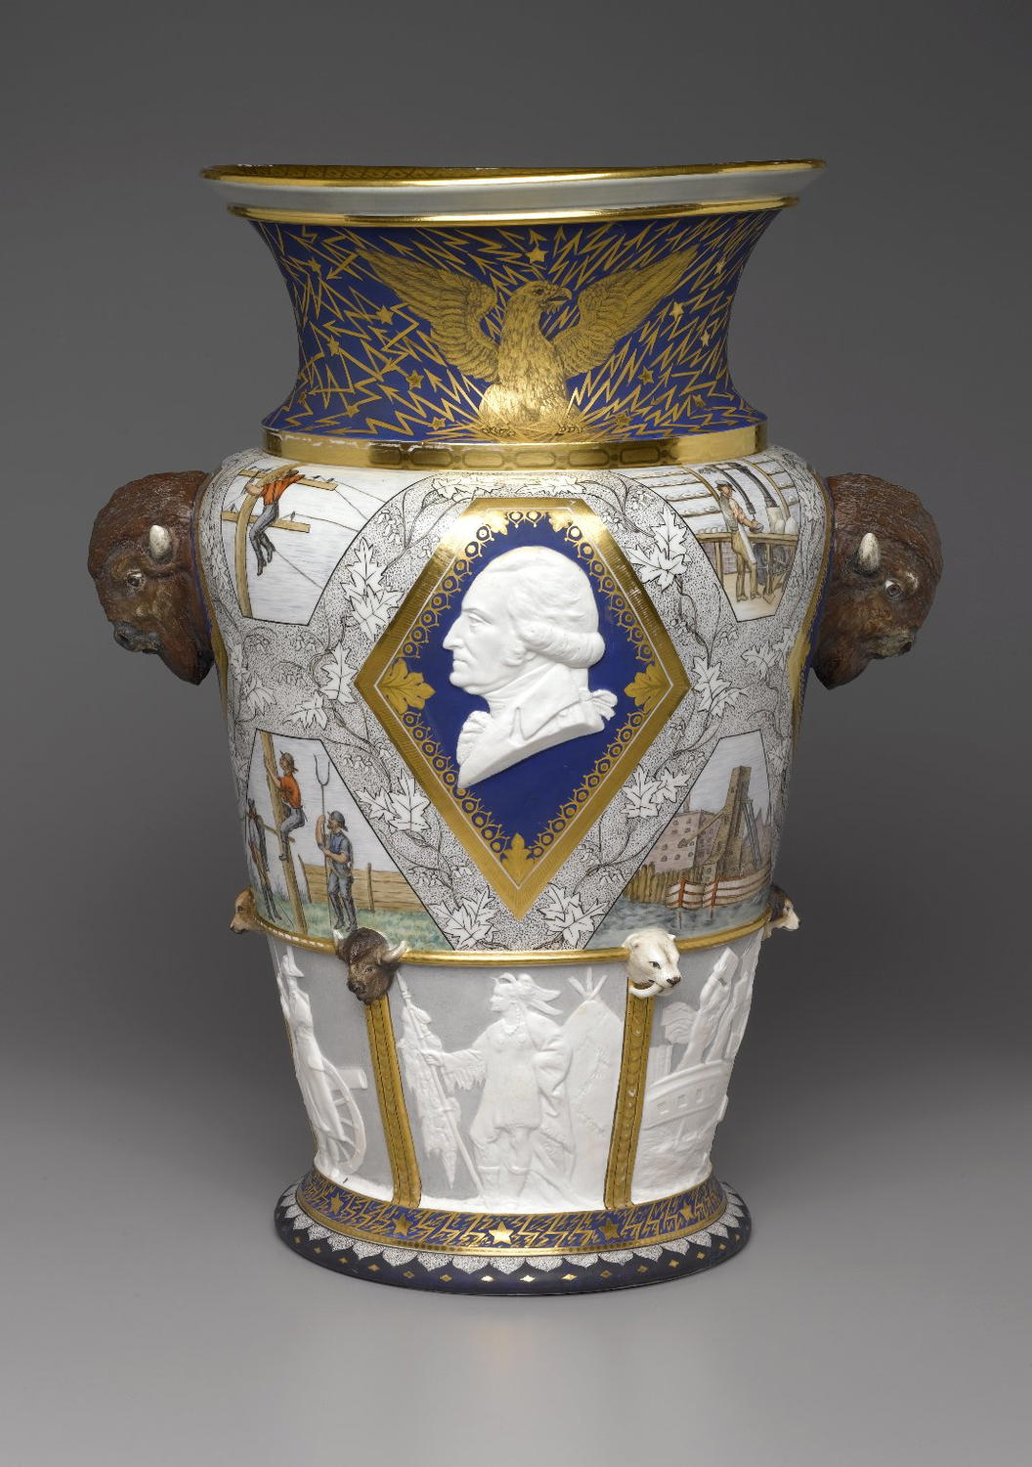

Slide 20
EARLY AMERICAN ART
Workshop 3
Our Changing Nation
ArtWorks NYC
Brooklyn 4th Grade Program 2026

Slide 21
American Revolution Art Review

Slide 22
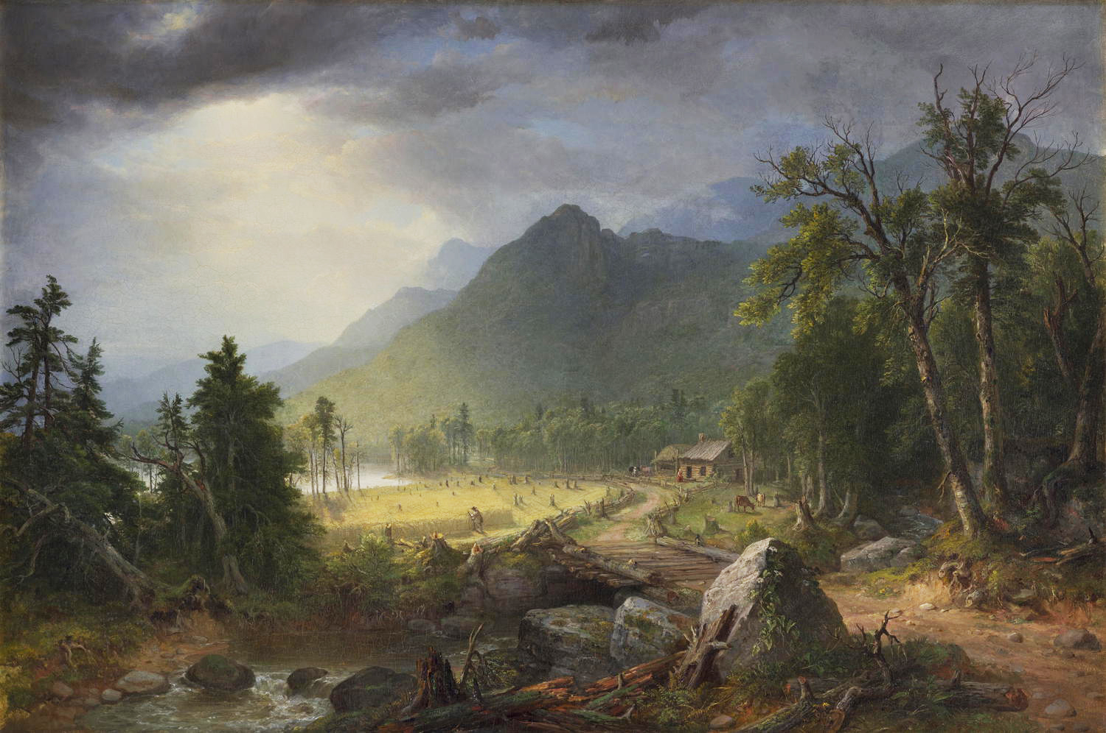

Slide 23
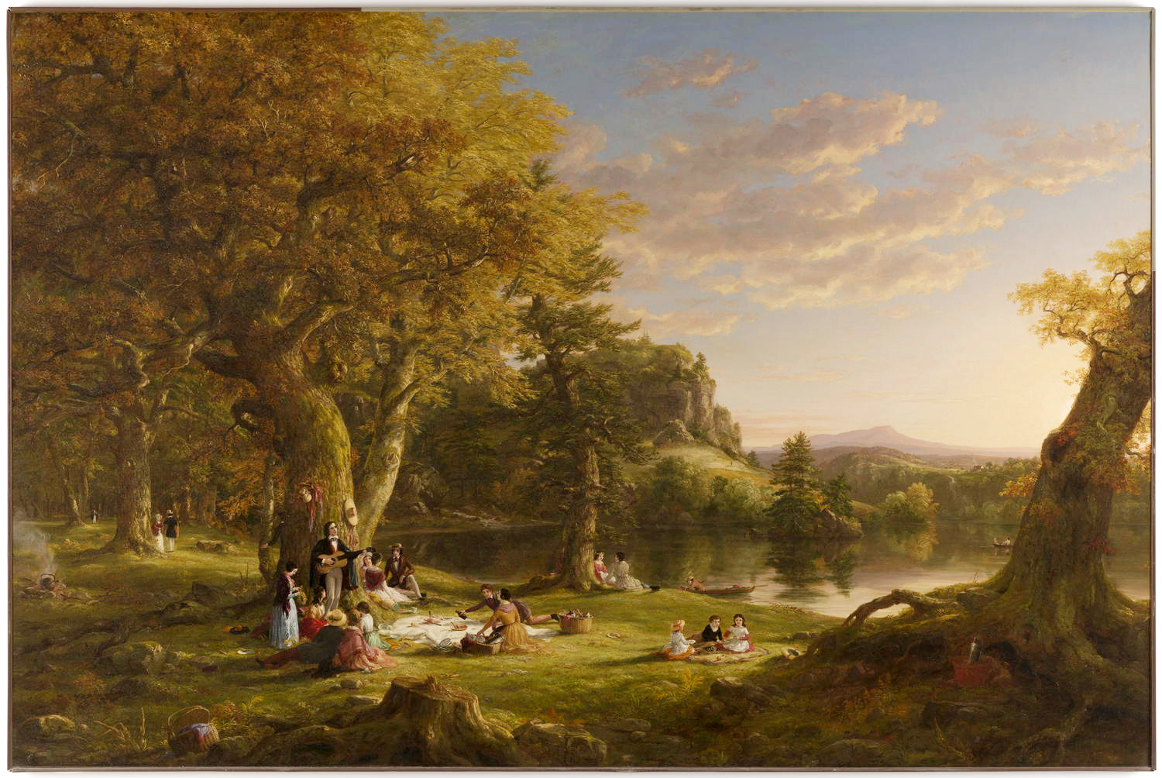

Slide 24
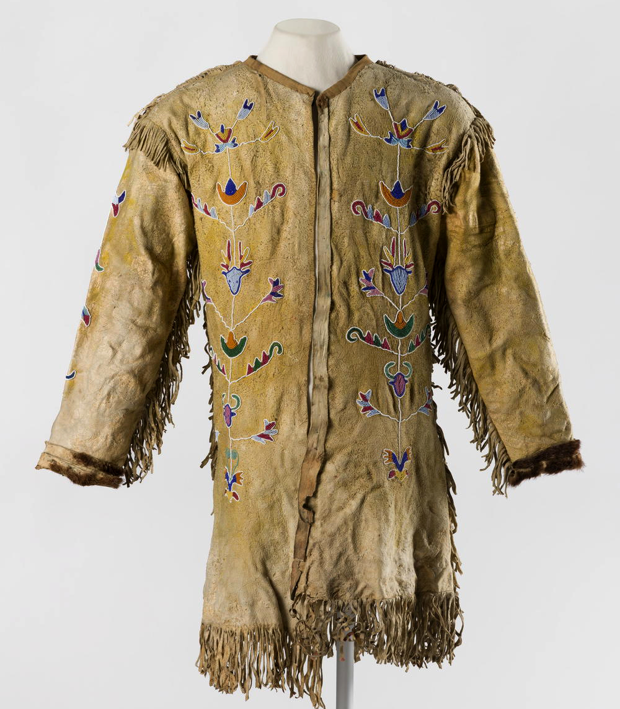

Slide 25
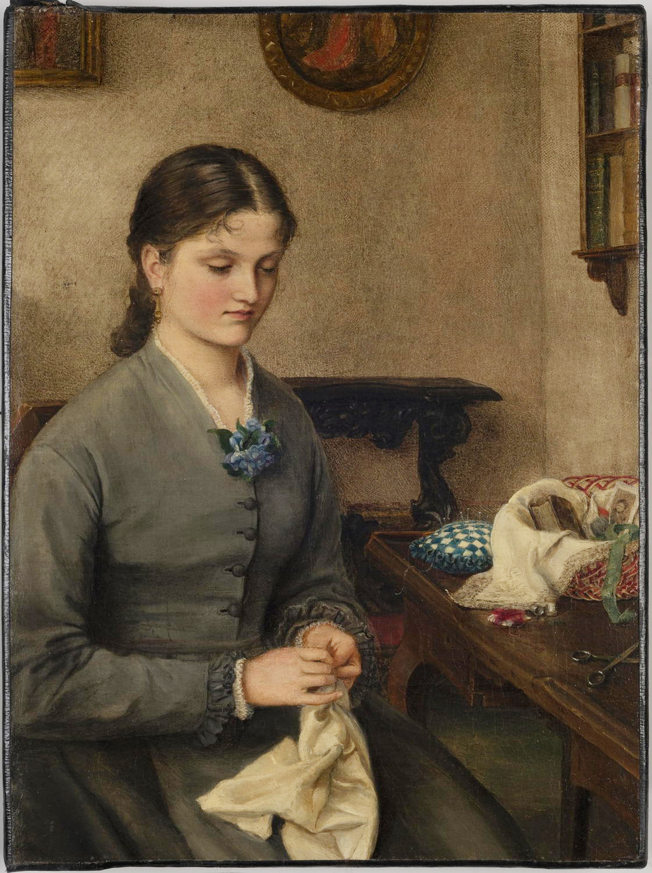

Slide 26
